Slide 1
Year C
Module 2: My relationships
5. Friendship

Slide 2
5. Friendship
Friendship
In this unit we will:
Recall the constructive habits in a relationship.
Take steps to build more caring relationships.
Reflect critically on the authenticity of my friendships – which of them are more real, connected and loyal?
Investigate how to deal with conflict when it arises in a friendship.

Slide 3
5. Friendship
Life skill focus
Prudence: Knowing how to look after my friendships.
Fortitude: Being courageous in facing conflict.

Slide 4
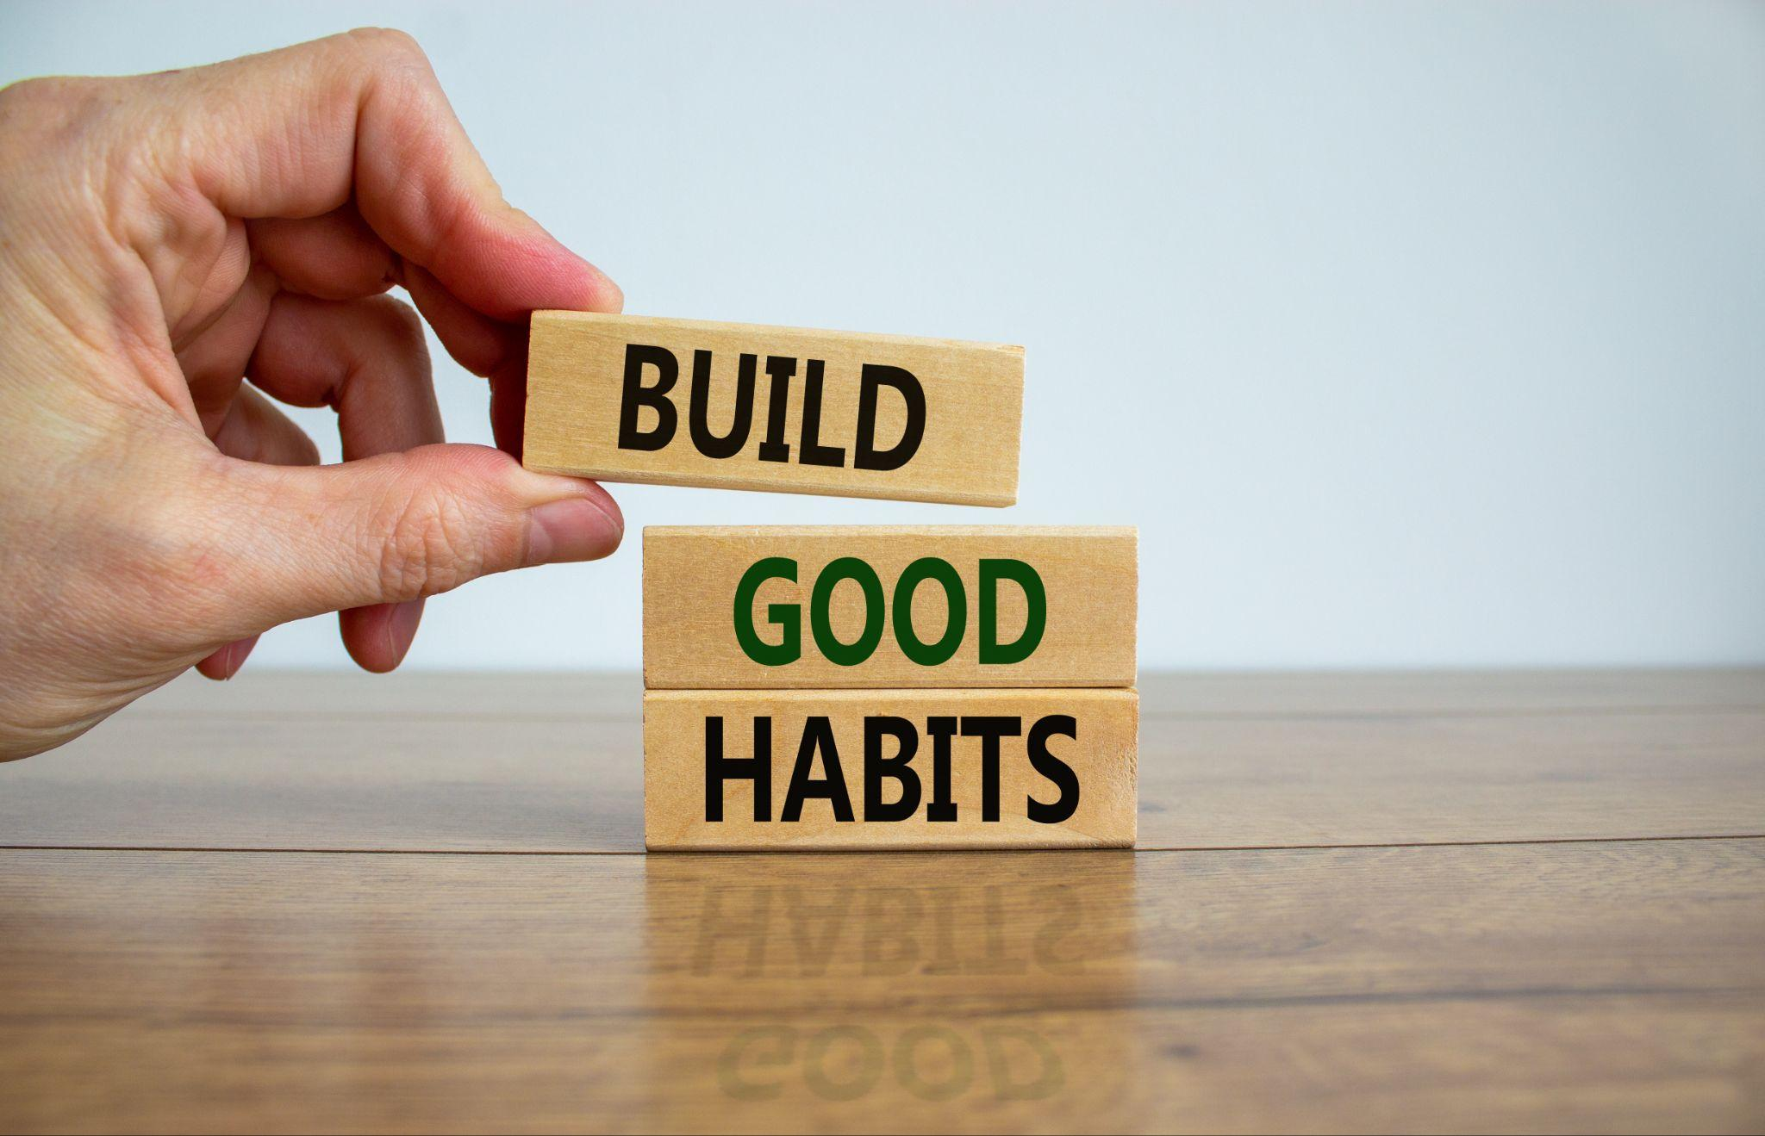
5. Friendship
Discussion
Sort this list of habits into the constructive and destructive relationship habits.
Think about which caring habits you appreciate the most, and which deadly habits you find most hurtful.
Listening Nagging Complaining Respecting Blaming Encouraging Accepting | Criticizing Threatening Trusting Supporting Punishing Bribing, rewarding to control Negotiating differences
Notes:
Invite students to either work in pairs or groups to discuss these and share their conclusions
Are there any other habits [good or bad] they can think of?

Slide 5
5. Friendship
Growing in Friendship - Dealing with conflict
1. Be honest but be considerate of the other person’s feelings.
2. Focus on sharing your thoughts and feelings rather than pointing out how the other person has acted badly
3. Allow the other person to share without interrupting.
4. Try to listen carefully to the other perspective without reacting defensively.
5. You can point out a person’s mistakes without using harsh criticism or shaming the other person.
6. Have realistic expectations – everyone makes mistakes.
7. Be willing to forgive.
8. If the other person is consistently using destructive rather than constructive habits in the friendship, and you are being repeatedly hurt, take care of yourself by letting go and moving on.
9. Is there anything that you are doing that is hurtful?
Notes:
Every relationship has to deal with conflict at some stage. If the conflict is brushed under the carpet, or dealt with aggressively, then the friendship will not thrive.
If dealt with constructively, conflict can help to build solid and lasting friendships.
This slide and the next have some guidelines to help get through conflict respectfully and to make friendships stronger.

Slide 6
5. Friendship
Discussion
Two scenarios to role to reflect on:
Sophie loaned Amy her favourite top to wear to a concert. Amy gave it back damaged and didn’t even apologise. Sophie is really angry and hasn’t spoken to Amy since.
A group of the lads were teasing Patrick about a girl he likes, and he was really embarrassed. His best friend John joined in with the lads and Patrick feels hurt.
Notes:
Suggestion:
Perhaps invite some students to act out a role play of these scenarios to stimulate class discussion?
How would they [as either Sophie or Patrick] attempt to resolve the conflict/hurt done to them by either Amy or John
True friends acknowledge when they have fallen short of authentic friendship and apologise
Real friends stand by you if you are subject to unjust or unfair treatment from others

Slide 7
5. Friendship
Be responsible
Choose three positive steps to take to build stronger friendships.
Notes:
How do you feel your friendships are going?
The teenage years can be difficult in terms of changing childhood friendships and feelings of loneliness and isolation when other friendships are slow to form, or when you feel excluded from groups in school. If you have experienced these challenges, do you have someone you can trust that you could talk to about it?
Have you experienced friends being there for you in the good times and the hard times?
Who do you feel totally yourself with? For a real friendship with someone, both people need to be real with each other – no pretending, no trying to impress, no masks. Are you real with your friends?
How do you feel about dealing with disagreements or conflict with your friends? Are you confident that you can work through any difficulties and keep the friendship strong?
Are there caring people who you could invest more time with?
Are there damaging relationships that you can decide to take a break from?

Slide 8
5. Friendship
Be connected, build resilience
Call to mind the good relationships in your life.
Visualise your friendships as golden threads connecting you to others… disagreements might come and go, but you can choose to keep that thread strong and steady.
Make a visual map of your strong friendships and write in what caring habits you experience in each one.
Notes:
This might be an exercise students can begin in class and finish off at home in private or just suggest they make a map in their own time.
Ask the students if they think such an exercise might be useful.

