Slide 1
Year C
Module 1: My Identity
4. My body and my identity

Slide 2
4. My body and my identity
My body and my identity
In this unit we will:
Define the term ‘gender dysphoria’.
Examine a variety of perspectives on how to support those with gender dysphoria.
Notes:
Gender Dysphoria
The feeling that you are the wrong sex, for example a boy who feels that he is or should be a girl or a girl who feels that she is or should be a boy.
GD can include hatred or rejection of the physical body and can cause great discomfort and distress.
Background reading for teachers - FREE download resource for educators https://www.transgendertrend.com/product/school-resource-pack-3rd-edition-digital-download/

Slide 3
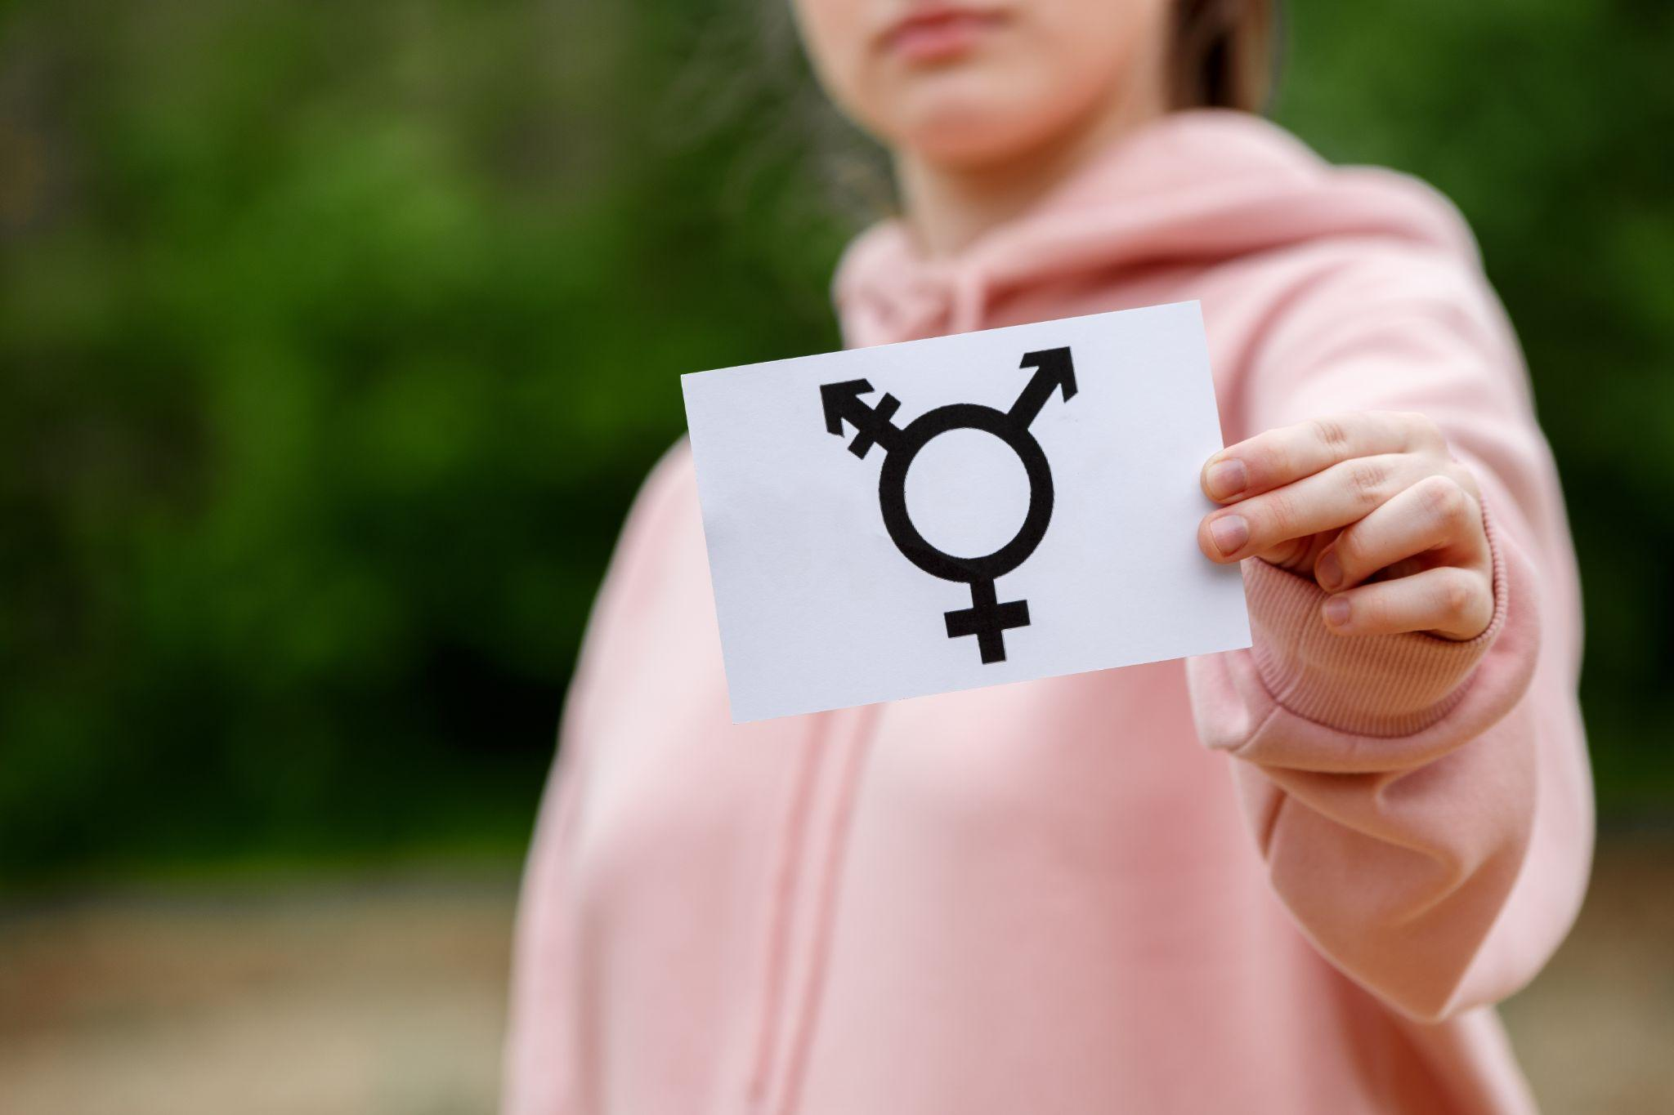
4. My body and my identity
Here are some facts about Gender Dysphoria (GD):
It is not explained by any biological factor – they are not intersex: the genotype and phenotype are typical.
It manifests in childhood usually during adolescence.
The majority [over 80%] who experience GD will grow out of it becoming comfortable with their biological sex.
Those who persist with GD are at higher risk of mental health problems, and need extra support and understanding.
There is ongoing debate in the medical profession about how to treat GD: counselling/psychotherapy is universally recommended.
Changing the appearance of the body using hormonal therapy and surgery are more controversial.
Despite the wide availability of these treatments there is no consensus within the medical community that they provide the best outcomes for patients.
Notes:
This sensitive topic will undoubtedly trigger some open debate [perhaps even intense in nature] among students. Teachers will know best when and how to allow such discussion to flow depending on the circumstances of each class and set of students

Slide 4
4. My body and my identity
What is gender?
There is another element to a person’s sex – what is known as ‘gender’.
As we have discussed, gender is mainly about social and cultural attitudes, but it also relates to how people experience their own identity.
Notes:
Gender identity:
A phrase previously used in child development texts to denote the child’s understanding of being male or female.
Current usage suggests an innate identity which is present from birth and immune to parental or societal influence.
It is described as a pre‑social deep inner sense of being a boy or a girl.
The idea of a ‘female brain’ in a male body is not supported by neuroscience research which shows that human brains are more of a mosaic of both ‘feminine’ and ‘masculine’ characteristics.
Although there are differences between male and female brains the human brain is not sexually dimorphic as it is not a biological reproductive sex organ.
Feminising or masculinising influences on the brain such as pre‑natal hormone levels do not override and cannot change a person’s biological sex.
It is important to acknowledge that gender questioning and feeling trans are influenced by a complex mix of cultural norms and personal predispositions (related e.g. to trauma and autism traits).
We must all be careful to be both kind and neutral – ‘affirming a child as a child’ is not the same as ‘affirming’ another gender or actively discouraging children to believe they are not trans. [ie not suffering gender dysphoria]
‘Wondering’ about identity and experimenting with roles can be part of growing up and most children with GD or seeing themselves as “trans” desist with the passage of time and development.

Slide 5
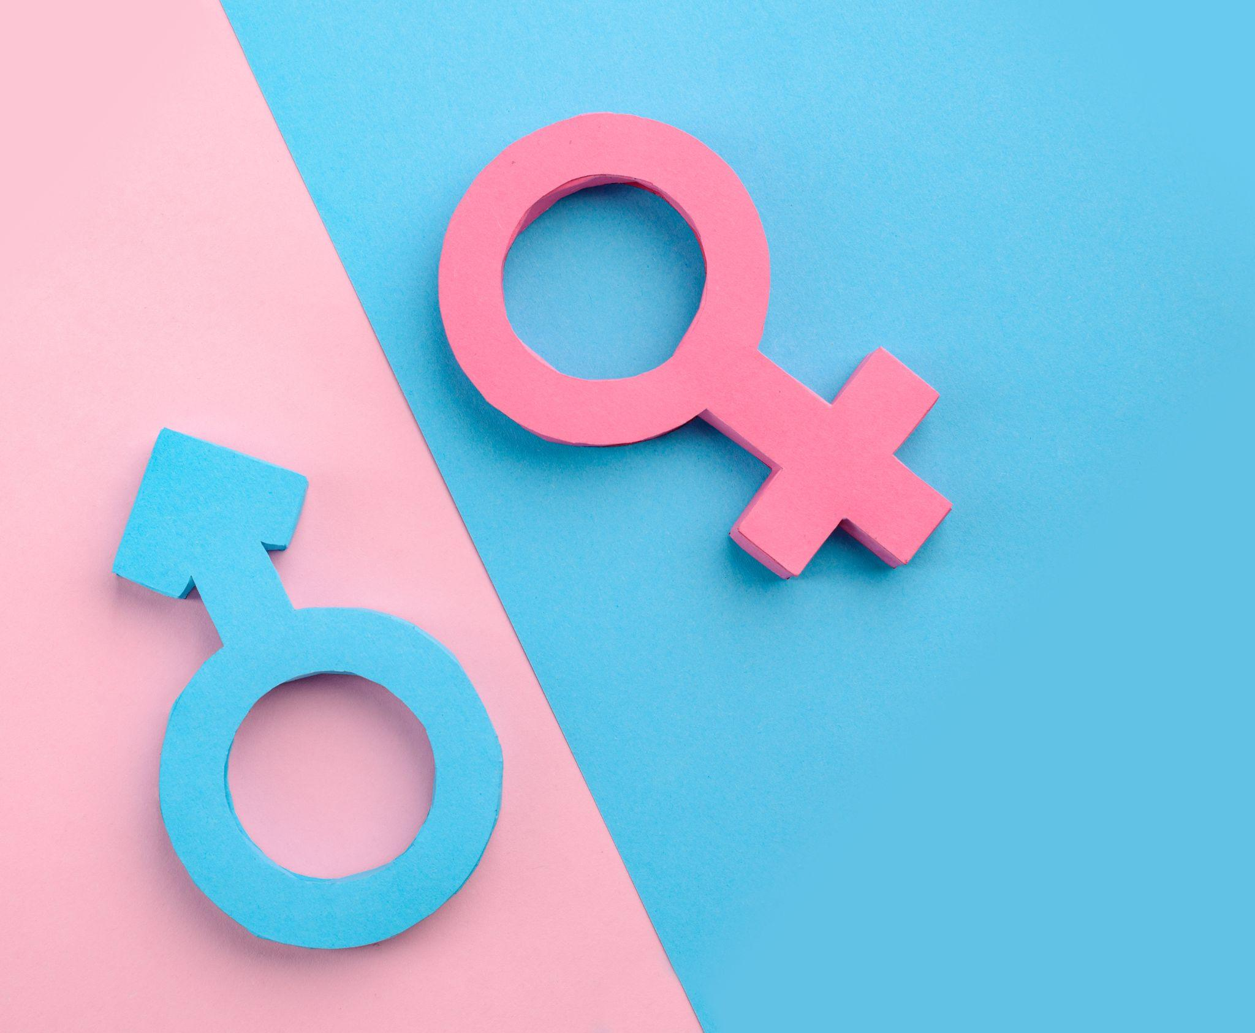
4. My body and my identity
A person’s gender entails their psychological awareness of what sex they are, rooted both in the person’s body and in their environment.
This awareness, which has an emotional aspect, develops when a young child becomes aware of the distinction between male and female, and recognises where he or she fits in.
It is important to remember that men and women are not merely different from each other, but that men differ in important ways from other men, and women differ in important ways from other women.
Not all women develop physically and emotionally at the same rates and in the same ways, and similarly men do not all develop physically and emotionally at the same rates and in the same ways.
Each of us is unique.
Notes:
Choosing our words carefully:
On the one hand, we ought to avoid simply picking up secular vocabulary, which is loaded with so much philosophical and political baggage that students may end up hearing the opposite of what Living Love is trying to convey.
At the same time, teachers need to be aware of the situation of students, and the reality that they come, not only with varied levels of engagement with and understanding of Church teaching, but also with diverse experience of the issue in their own families and circles of friends.
To cede the rhetorical ground to the culture risks diluting or distorting the message of Living Love
To insist too rigidly on technical theological terminology risks losing people whose primary connection with the topic is personal and primarily emotional.
Better to speak of “people who experience confusion regarding their sexual identity” [which keeps the dignity of persons central to the discussion] rather than “trans people” as if they were a different category of person with a different type of human nature; to use labels creates the very isolation and “othering” that the Living Love teaching and pastoral care is intended to repair.

Slide 6
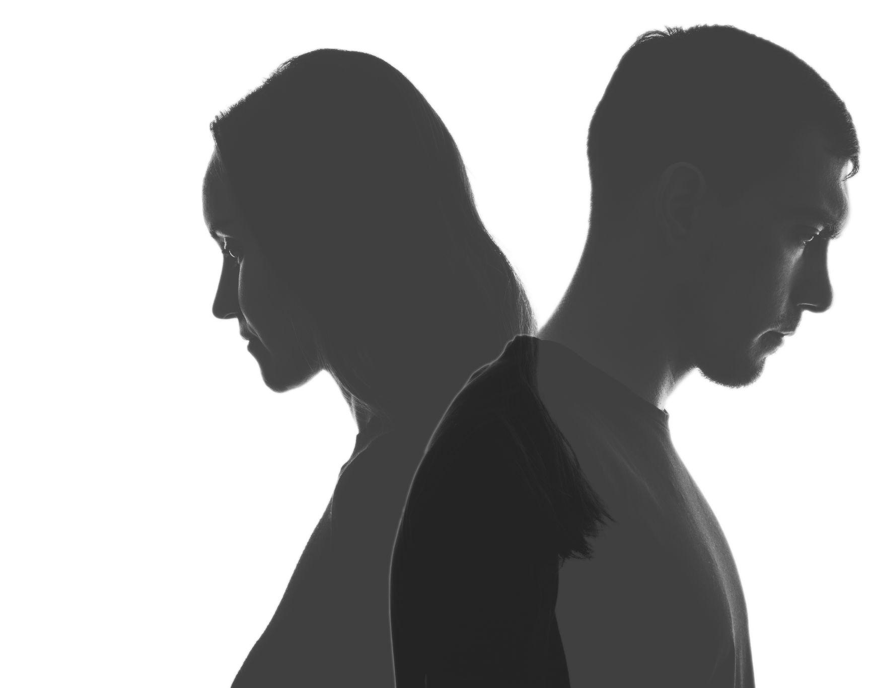
4. My body and my identity
Those who refer to themselves as ‘non-binary’ feel they don’t fit into a typically male or female classification of their body.
This does not mean that the Person is literally neither male nor female but because this ideology links the physical body to feelings in the head, young people may seek to take cross‑sex hormones.
Some girls may seek to bind their breasts or feel they need a double mastectomy in order to create a ‘non‑binary’ body.
In reality, nobody has exclusively ‘feminine’ traits or exclusively ‘masculine’ traits. We all share in the attributes of both sexes.
Notes:
Gender fluid:
Someone who identifies as a boy one day and a girl the next and may change their style of dress from stereotypically masculine to stereotypically feminine to reflect this.
As with non‑binary gender, the ideology suggests that identity equates to material reality but a person does not in fact become literally male or literally female on different days.
Intersex:
Intersex people are those who are born with one of various congenital abnormalities known collectively as disorders or differences of sexual development (DSD).
In very rare cases a newborn’s genitalia is difficult to classify as either male or female at birth.
A DSD or intersex condition does not change a person’s sex, which is still either male or female.
There are female DSD conditions (eg Congenital Adrenal Hyperplasia (CAH) and Turner Syndrome) and male DSD conditions (eg Klinfelter Syndrome).
A person with a DSD is not a third sex, nor on a ‘spectrum.’
Intersex is unrelated to transgender and should not be conflated as the issues are very different.

Slide 7
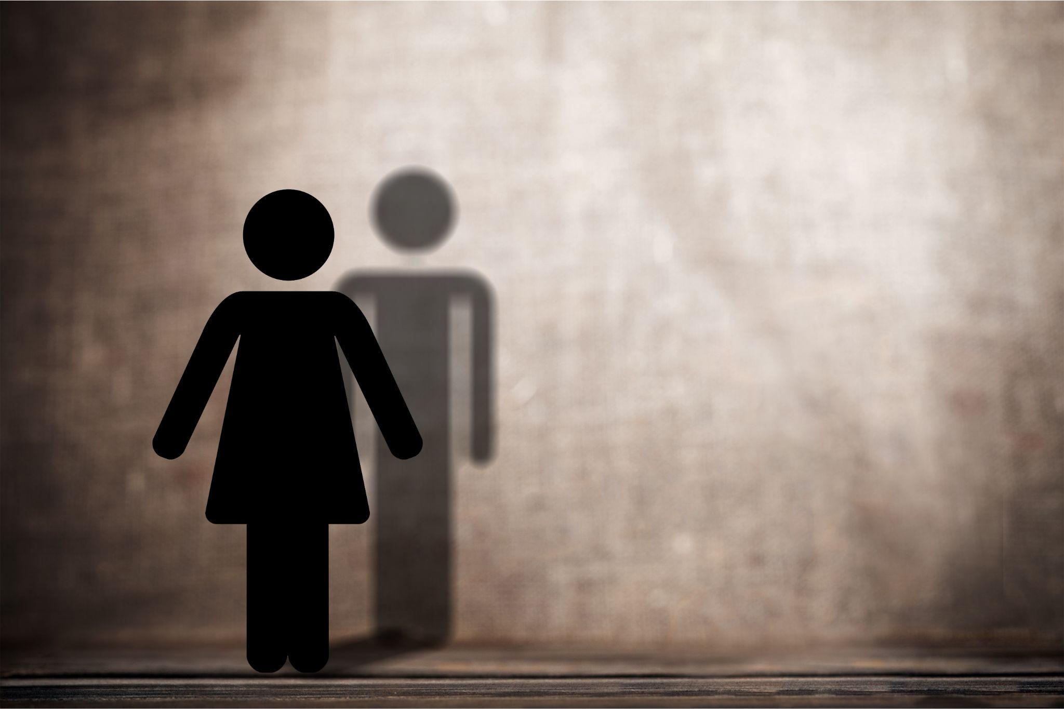
4. My body and my identity
Here are two different ways of looking at gender dysphoria: Perspective A
It is not possible to have a different gender to one’s biological sex.
In this view, the body is important and it shows the reality of a person’s gender, while their thoughts/feelings are out of sync with that reality.
In other words, one cannot be a man trapped in a woman’s body, and one cannot change from being a boy to becoming a girl or vice-versa.
Notes:
Therefore any treatment needs to focus on the thoughts and feelings of the person who identifies as transgender, and help them to accept the reality of their body.

Slide 8
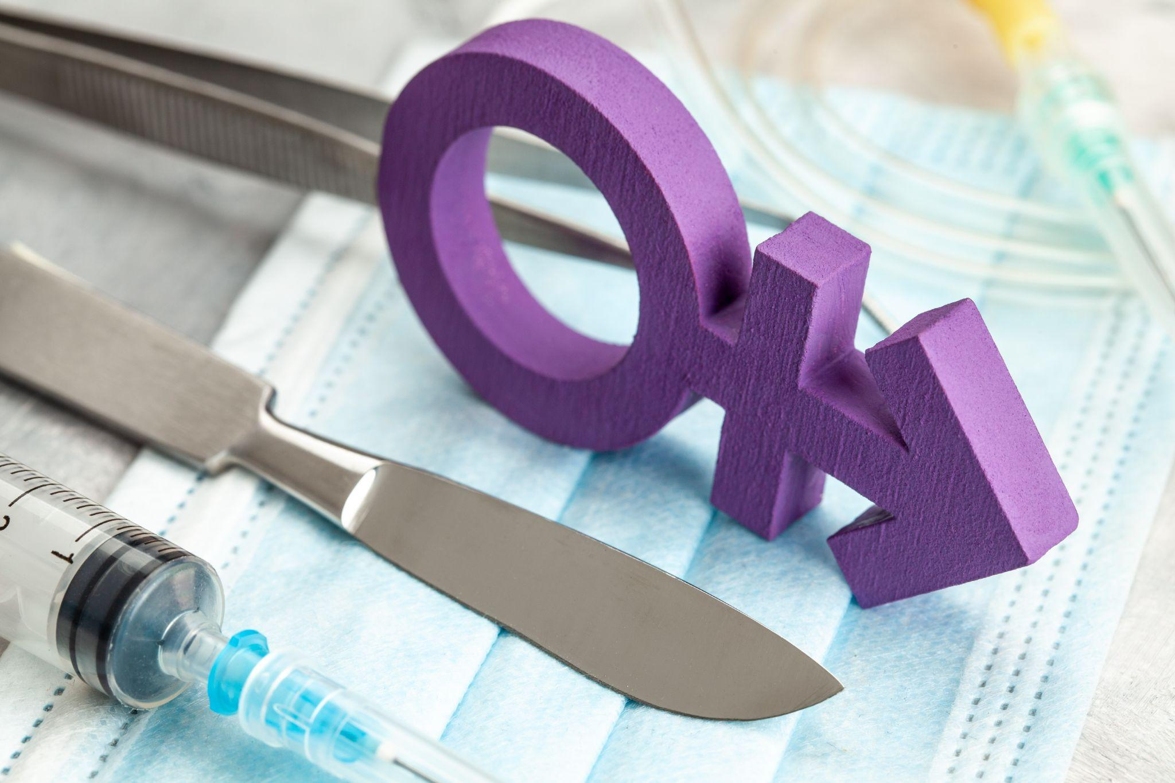
4. My body and my identity
Here are two different ways of looking at gender dysphoria: Perspective B
It is possible to have a different gender to one’s biological sex.
The person’s mind or feelings are seen to express the reality, and the body is not a true source of reality.
In other words, it doesn’t matter what type of body you have, you can choose whether you are a boy or girl, man or woman, and you can get your body changed to match your thoughts about this.
Therefore treatment focuses on changing the body to match the mind and feelings.

Slide 9
4. My body and my identity
There are different views on the best way to help someone with gender dysphoria, depending on which perspective you have (as seen in the previous slides).
Many transgender communities emphasise the importance of affirming the person in the gender that they choose, using the person’s chosen new name and the pronouns (he/she) that reflect the gender that they feel they are on the inside, even if their body does not match that feeling, allowing them access to facilities of their choice, such as toilets etc.
Others encourage counselling to help the person integrate their body and their feelings into their identity.

Slide 10
4. My body and my identity
Perspective A Medical approach
Many medical professionals are concerned about the long-term implications of the medical and surgical interventions for GD, and recommend caution, because the experience will be temporary for the vast majority of children and teenagers who experience it.
It persists into adulthood for a small minority, but there is no way of telling who will grow out of the experience and who won’t.
Doctors recommend ethical psychotherapy to assist young people going through this rather than prematurely prescribing hormonal drugs to block puberty, or cross sex hormones to radically alter physical development.
Notes:
Watch and Wait approach:
The established global model of care for children with gender dysphoria is a ‘watch and wait’ approach which may include two other models which are sometimes distinguished separately: ‘developmental’ and ‘exploratary’.
None of these models steers a child towards any pre-determined outcome, but all recognise developmental change as an intrinsic part of childhood and adolescence.
Remind students that the great majority of GD sufferers [well over 80%] will desist from their confusion with proper therapeutic help and eventually be at peace in the sex of their conception and birth.

Slide 11
4. My body and my identity
Perspective B Medical/surgical approach
In the medical field it is possible to treat gender dysphoria with drugs to prevent the onset of puberty, followed by hormonal treatment with hormones of the opposite biological sex.
Sometimes this is followed by surgery to remove or replace the genitalia. People with GD can be vulnerable to mental health problems whether or not they pursue medical/surgical treatment for their condition.
They need care, support, understanding and appropriate mental health intervention.
Notes:
The ‘gender affirmative model’ or ‘affirmation’ approach
The ‘gender affirmative model,’ or ‘affirmation,’ is an experimental approach towards children and young people with gender dysphoria.
It is not a model which has been informed and developed through clinical research and evidence but one which has been promoted by transgender lobby groups and activists.
Resorting to puberty blockers and [when legally permitted] gender reassignment surgery can cause long term and lifelong negative emotional and physiological side effects.

Slide 12
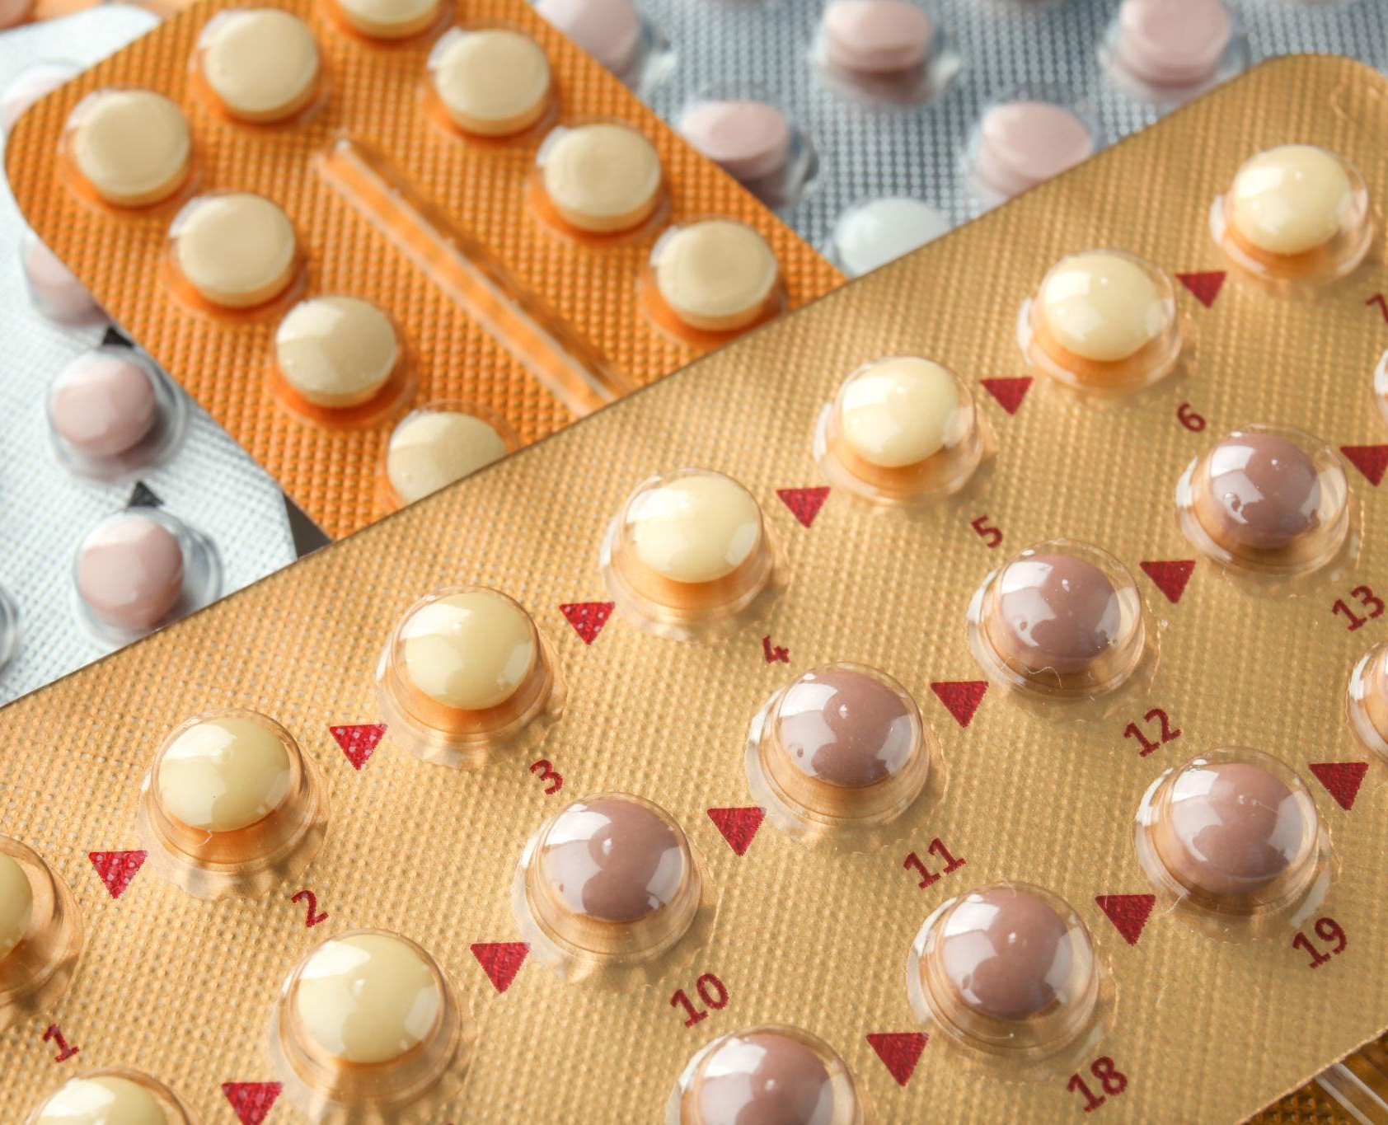
4. My body and my identity
One of the concerns that doctors have is that there is very little research to date about what the long-term health implications are for people who start taking hormonal treatments at a young age, and have to stay taking them for the rest of their lives.
Some side effects are already known about, but nobody knows how people on these drugs will be affected in years to come.
Also, there is limited evidence so far that hormonal treatment and surgery improves the mental health outcomes of those with GD over the long-term.
Notes:
There are an increasing number of young people who transitioned from one gender to another and now regret that decision.
“Detransitioners” are finding their voice - link below will take you to some of their stories and testimonies which may be useful for classroom discussion
https://www.bayswatersupport.org.uk/detrasitioners-videos/

Slide 13
4. My body and my identity
Faith perspective
The message of Jesus for everyone is:
Every human person has innate dignity and should be treated with respect
Every person is cherished and loved by God
Every person is made of body and soul, and both body and soul deserve reverence and respect
It is always a sin to bully, mistreat or denigrate another person on any basis, including transgenderism and sexual orientation.

Slide 14
4. My body and my identity
It is impossible to separate the person from their body. A person’s thoughts or feelings are not more real than their body – the body has an important meaning and expresses who the person is.
While our thoughts may sometimes be in error and our feelings sometimes be inappropriate, our bodies are never ‘wrong’ or ‘inappropriate’.
It is not always in the best interests of the person to try to medically or surgically change their bodies. Performing surgery on a healthy body in order to treat a psychologically experienced problem is not appropriate.
Counselling, psychotherapy and accompaniment are the best and most appropriate forms of treatment to help the person integrate their identity. Patient compassion and understanding is paramount.
Notes:
The body is an inseparable expression of the human person, and the Catholic
Church teaches that you cannot choose your own gender as different from your biological sex.
Rather, each person is given the gender of their biological sex by God.
The human person is a holistic union of body and soul.
[background reading] The Vatican department for education produced the following guidance https://www.vatican.va/roman_curia/congregations/ccatheduc/documents/rc_con_ccatheduc_doc_20190202_maschio-e-femmina_en.pdf
education on sexuality and affectivity must involve each person in a process of learning “with perseverance and consistency, the meaning of his or her body” 35 in the full original truth of masculinity and femininity. It means “learning to accept our body, to care for it and to respect its fullest meaning […] Also, valuing one’s own body in its femininity or masculinity is necessary if I am going to be able to recognise myself in an encounter with someone who is different

Slide 15
4. My body and my identity
Summary
The Church teaches that it is not possible to choose a gender different to that of the body, and that bullying or mistreating or maligning persons who identify as transgender is wrong.
There is no conflict between truth and love. The truth is that our identity is rooted in and expressed by our natural bodies, and the truth is that we are called to love everyone regardless of whether they accept the first truth or not.
Should a person with GD choose to undertake medical or surgical treatment to transition to the gender of their choice, that does not change anything about how valuable the person is in the eyes of God.
That person is entitled to respect, love, and dignity.
Notes:
Be responsible:
What can you do to prevent bullying or to stand up for those who are bullied?

