Slide 1
Year A
Module 2: My Relationships
7. Building relationships

Slide 2
7. Building relationships
Building
relationships
In this unit we will:
Critique the idealisation of romantic love in TV and film.
Sort a range of behaviours into those which build friendship and those which damage it.
Reflect on personal experiences of friendship and take responsibility for moving towards stronger relationships with friends.

Slide 3
7. Building relationships
Life skill focus
Fortitude: have the courage to build good friendships and to take action if you are not being treated well in a friendship.
Justice: treat others as you would like to be treated.

Slide 4
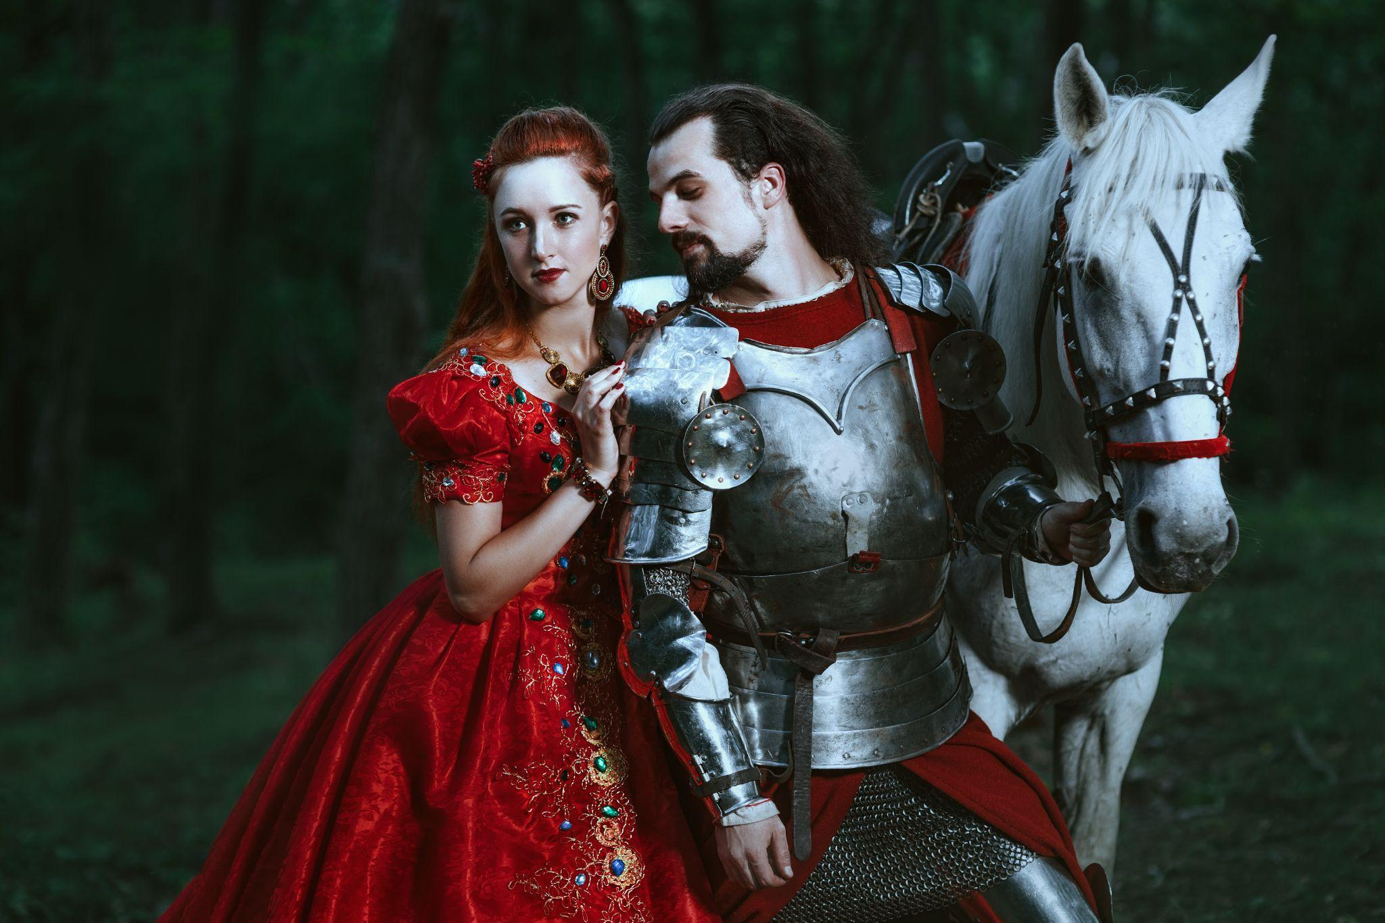
7. Building relationships
Some movies paint a very unrealistic picture of romantic relationships as fairy tales. When the two partners meet and get together, they enter into a blissful happy ever after. This does not happen in real life. Even non-romantic friendships have their ups and downs. In reality, making a relationship thrive requires effort on both sides.
Notes:
Brainstorm to come up with some well-known fictional romantic couples from TV, books or movies.
How does their romance develop?
Does it seem realistic to you?
Do the couple have to make any effort to work on their relationship or does it seem easy, like a fairy-tale?
What is likely to happen to the couple after the story ends?

Slide 5
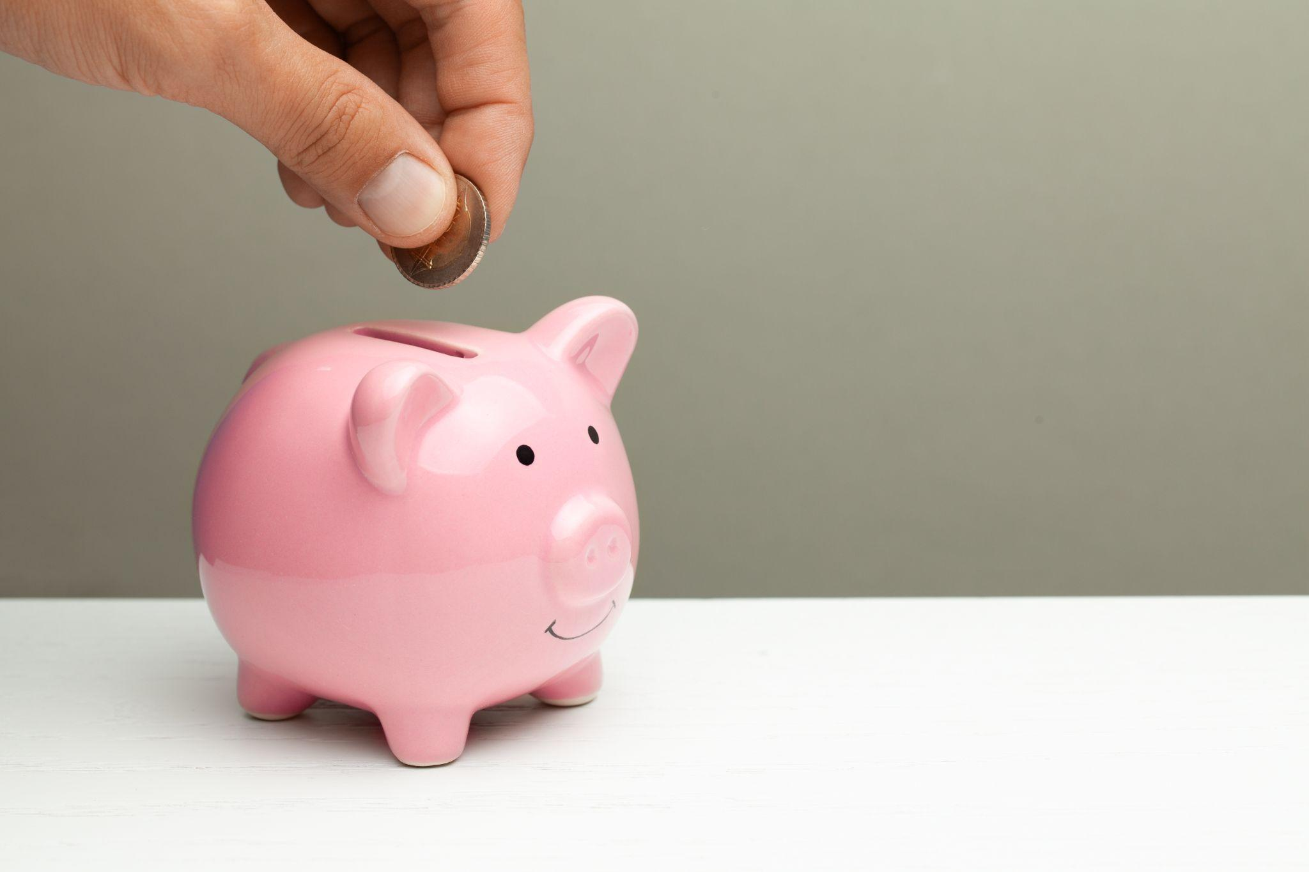
7. Building relationships
If you have a savings account in the bank, you will know that if you keep withdrawing money without putting any in, eventually the bank account will be empty. In a similar way, all relationships need investment. Relationships flourish when we spend time together, pay attention to each other, make a point of being there for each other, find new ways to make space for the relationships, have shared traditions, and are willing to forgive.

Slide 6
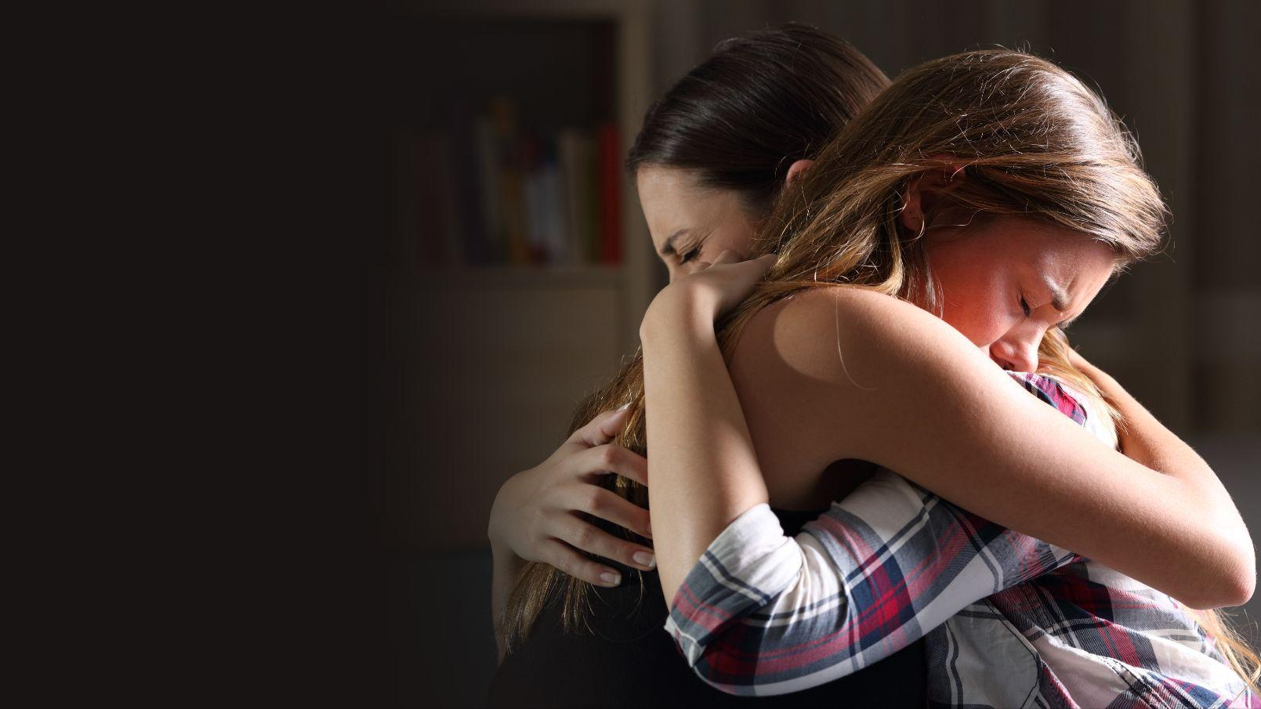
7. Building relationships
Look at the list below and separate them out into the kind of things that build up relationships and the kind that take a toll on them.
Listening
Criticising
Shouting
Spending quality time (e.g. doing activities together)
Sending a thoughtful message
Being on the phone while spending time together
Affection
Praying together
Focusing on the other person’s faults
Being dishonest
Consoling during difficult times
Making an effort to see the person
Controlling the other person
Making fun of the other person in front of others

Slide 7
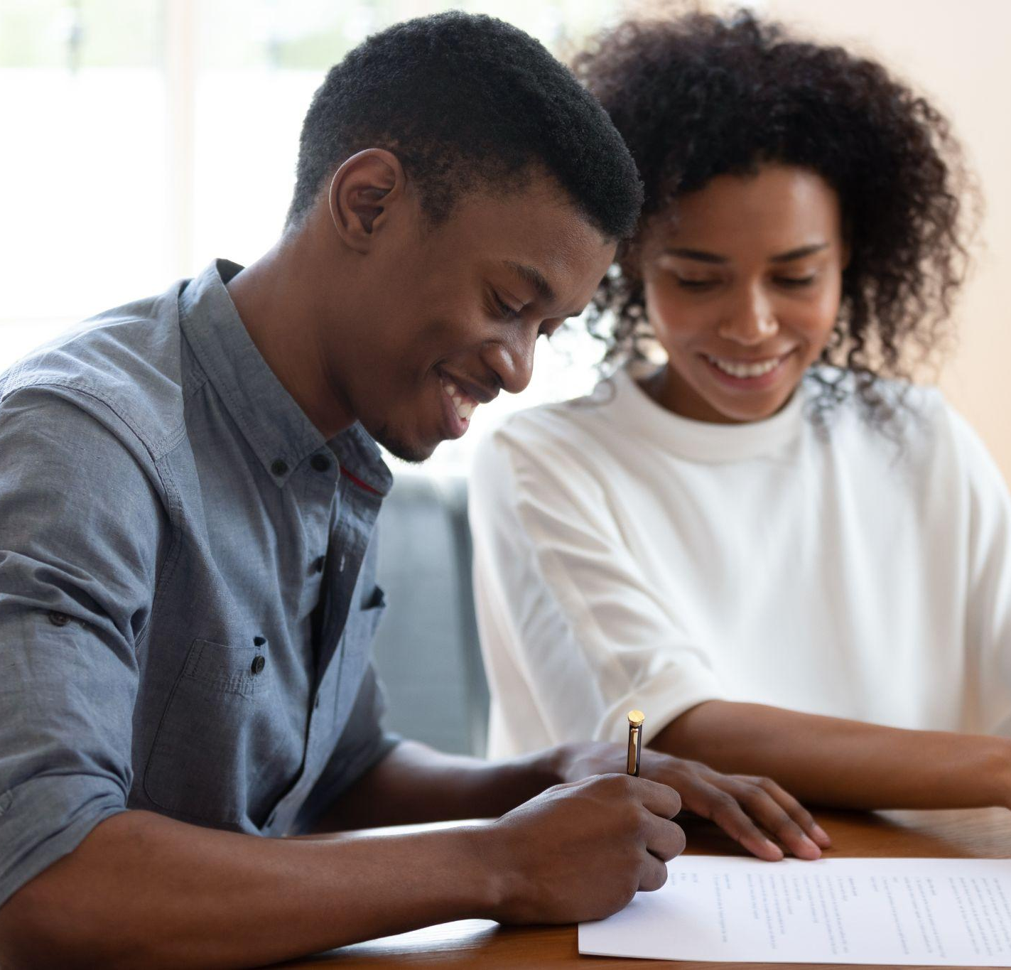
7. Building relationships
Be responsible, be connected
What will you choose?
I can look at my habits and actions and try to figure out whether they are building or tearing down friendships.
I can choose to practice more caring habits in order to invest in good friendships.
I can reflect on which friendships in my life are the most positive and uplifting.
Notes:
Build resilience, be connected
Suggestion:
Invite students to take some time to visualise the kind of friend they want to be.
Perhaps suggest they choose two or three small steps to work towards that goal, perhaps writing it in their “gratitude journal” without being overly critical of themselves
If there are relationships where you are on the receiving end of hurtful behaviour, encourage them to reflect on how to exercise some self care.

