Slide 1
Year A
Module 1: My Identity
4. The language of the body

Slide 2
4. The language of the body
The language of the body
In this unit we will:
Practice interpreting a person’s feelings through their body language
Compare different perspectives on the importance of the human body and how it relates to my identity
Take ownership of my personal perspective on the importance of the body and reflect on the Implications of that perspective for self-care
Explore how my understanding of the body impacts on my understanding of what sex means

Slide 3
4. The language of the body
Life skill focus
Prudence: understand the importance of my body and the respect I deserve in my body.
Temperance: understanding how moderation and self-control are important for looking after our bodies.

Slide 4
4. The language of the body
Pair work: exploring images
Look at pictures 1-5
What is going on for the person in each picture?
Can you tell what feelings or thoughts they are experiencing?
Notes:
It’s important to emphasize that we’re asking the students to express what they “think” is going on for the persons in the images - so unless a person’s behaviour is obvious, we can only make an assumption about their feelings. What matters is to be attentive,aware of the signs people give about the mood they are in or emotions they might be going through, especially if they are negative ones.

Slide 5
4. The language of the body
Pair work: exploring images
Look at pictures 6-10
What is the dynamic between the two people in each picture?
What are they communicating to each other with their bodies? Can you explain your reasoning?
Notes:
Suggest taking a moment to look at the images quietly, then share with a partner what their impression is
When it’s time, invite students to share their impressions of the images and why
Remind them that our bodies “speak” of who we are, how we are feeling and to be aware of our physical /bodily presence and that of others is a mark of emotional maturity and growing self-respect

Slide 6
4. The language of the body
Sometimes it can be difficult to interpret the body language of others.
It’s not just how they look, or gestures they might make but also being aware of their tone of voice and eye contact.
Notes:
Invite students to share perspectives and ideas about what and how persons communicate through their body langauge
Suggestion: ask for volunteer[s] to demonstrate different emotions to the class with body language without the volunteer speaking. Invite their classmates to raise their hand if they can guess what emotion is being expressed.

Slide 7
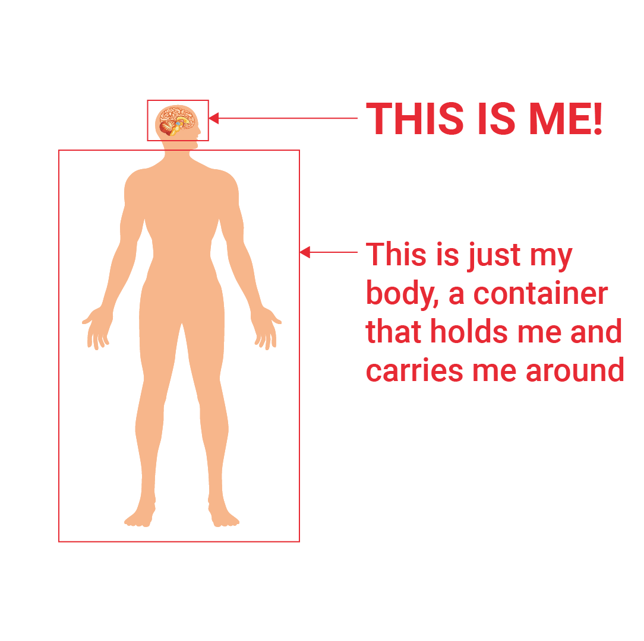
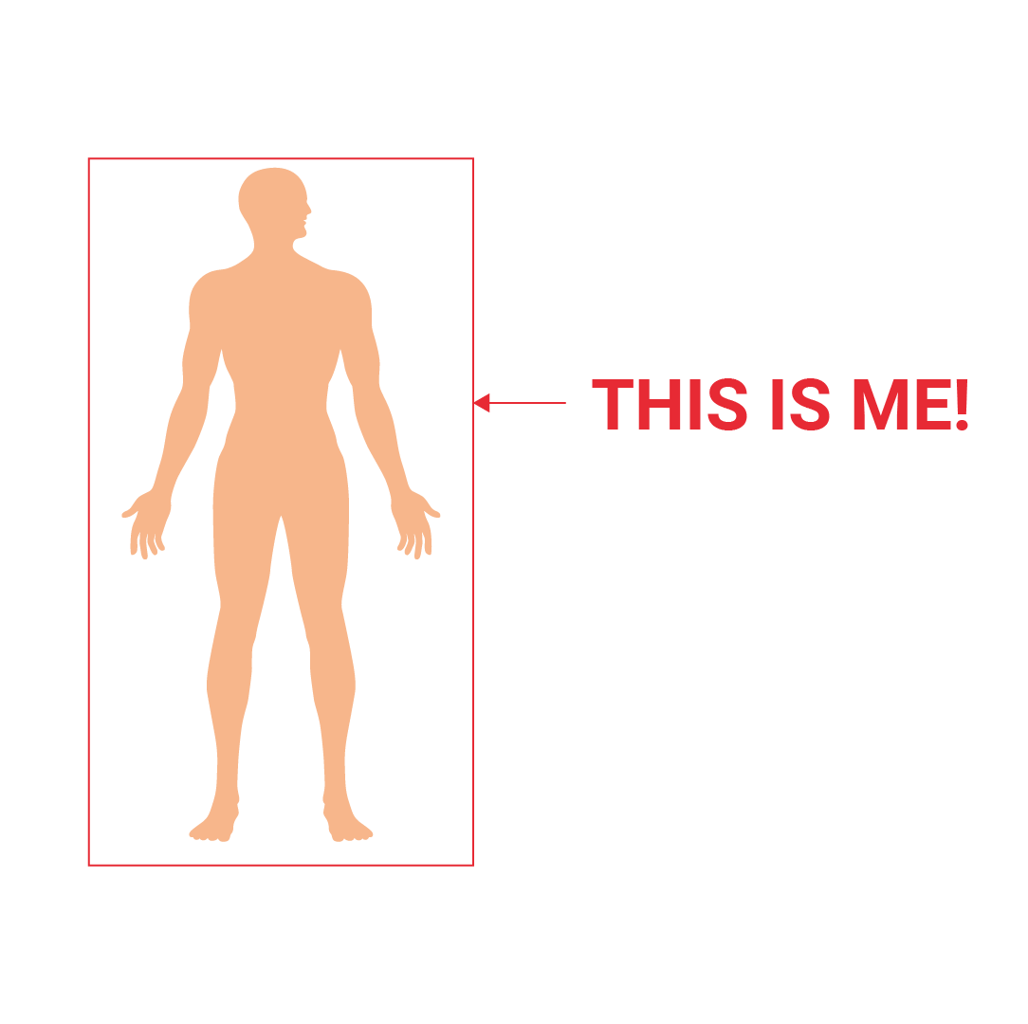
4. The language of the body
Here are two different perspectives on how your body relates to who you are.
A: Dualistic: The real person is inside – my thoughts and feelings make up who I am, so my body is something I live in.
B: Holistic: Body, mind, heart, soul all make up the real person. You can’t separate out an individual part.
Notes:
We want students to reflect on how important the body and their bodily awareness is.
Ask them “What makes you who you are? Is it your thoughts, your feelings, your heart?”
Where does your body fit in?
Finally ask the students which of the images best reflects your understanding of how the body relates to who you are? Why?
So does it make any difference to how you treat your body?
Which of these do you think is the Christian understanding?

Slide 8
4. The language of the body
Image A is a common understanding in our secular Western culture.

Slide 9
4. The language of the body
Image B is the Christian understanding. The body is an integral part of who a person is, communicates that person to the world, and therefore needs to be treated with great respect. The body and who you are cannot be separated. You are a human being worthy of respect and your body should share in the respect and good treatment that you deserve.
Notes:
To help illustrate this teaching perhaps ask/explore the following:
When you see a parent cuddling their child, do you think they are communicating their love of the child or just their body?
If a someone, even a friend physically hurt you – would you think ‘Oh, it’s just my body.’ Or would you feel hurt/offended deep down in your heart and soul too?
It’s obvious then, that what we do with our bodies and how we physically interact with others is of great importance. It’s more than just a case of being sensitive and considerate about the feelings of others - do you agree?

Slide 10
4. The language of the body
You may be familiar with the word ‘reverence’ when it’s used for holy things – a special respect and honour for something that is seen as particularly special.
For a Christian, reverence is the only appropriate way to treat the human person, and therefore the human body, because it is not possible to separate the body from the person.
God has created us as bodily beings, and God himself became fully human when Jesus was conceived in Mary’s womb. The fact that the Second Person of the Blessed Trinity became a human embodied person in Jesus of Nazareth gives even greater dignity to us.
Notes:
Explain to the students how St Paul describes the body as a “Temple of the Holy Spirit” – a dwelling place of God himself, meaning that it needs to be treated with the greatest of respect
Invite a student to read the following passage from St. Paul’s First Letter to the Corinthians, chapter 6, verse 19-20 [1 Cor. 6:19-20]
“Do you not realize that your body is the temple of the Holy Spirit, who is in you and whom you received from God? You are not your own property, then; you have been bought at a price. So use your body for the glory of God.”

Slide 11
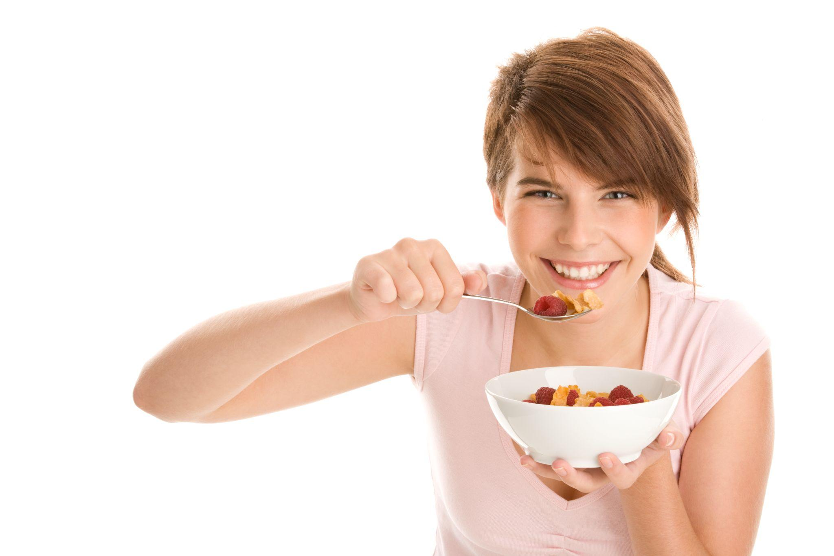
4. The language of the body
Which of these practices treats the body with reverence, and which doesn’t?
Eating a healthy diet
Taking regular exercise
Getting drunk and losing control of one’s body
Smoking
Dressing well for important occasions
Starving oneself to try to look thin
Steroid use to gain muscle mass
Eating a lot of junk food
Notes:
Suggestion. Depending on time, use the list as a way of stimulating general discussion on what is good/bad for one’s body, mind, heart and soul.

Slide 12
4. The language of the body
The Christian vision of the dignity of the body is central to understanding the meaning of sex
A: If we only have a dualistic understanding in Image A, the body can be used for sexual experience, but the person remains separate since the person is separate from the body.
B: The holistic understanding in Image B, says the soul and body are a unity, so whatever the body experiences fully involves that whole person.
Notes:
Explore with students how
If someone disrespects you or hurts you in a sexual way, it doesn’t just hurt your body, you as a person are hurt.
Think about how when we feel embarrassed we blush or how and when we’re excited you might feel ‘butterflies in the stomach’.
When you’re hungry or tired you might feel irritable.
Sometimes when you’re worried you might feel a choking sensation, or your stomach might cramp up.
If somebody mocks something about your appearance, it can hurt you emotionally – it might be easy to brush off insults if they were directed at things, but do we really think of our bodies as ‘things’?
Even the enormous respect and dignity we show the bodies of deceased persons ought to remind us that we cannot afford to be “casual” about our own bodies and the bodies of others.
Sexual feelings are highly delicate emotions and we must always remember that a person’s integrity and dignity is at stake depending on how we choose to act upon them
The holistic view that bodies are integral to our identity explains why this is so, while the dualistic view is not able to make full sense of the idea that what happens to our bodies matters to us personally.

Slide 13
4. The language of the body
We can use our bodies to express the love we have for others – from a simple affectionate arm around the shoulders, to a hug or a kiss.
The most profound and intimate way we can express love in and through our bodies is in the act of sexual intercourse in marriage.
Notes:
Explain why sex in marriage between spouses is truly “making love” because the couple are responding to the presence of the Holy Spirit in their bodies by co-creating with God a visible expression of His love in their relationship but also for the Church and world.
This is why sexual fidelity between spouses [whilst being deeply personal] is one sense not just private between them, it has widespread social implications.

Slide 14
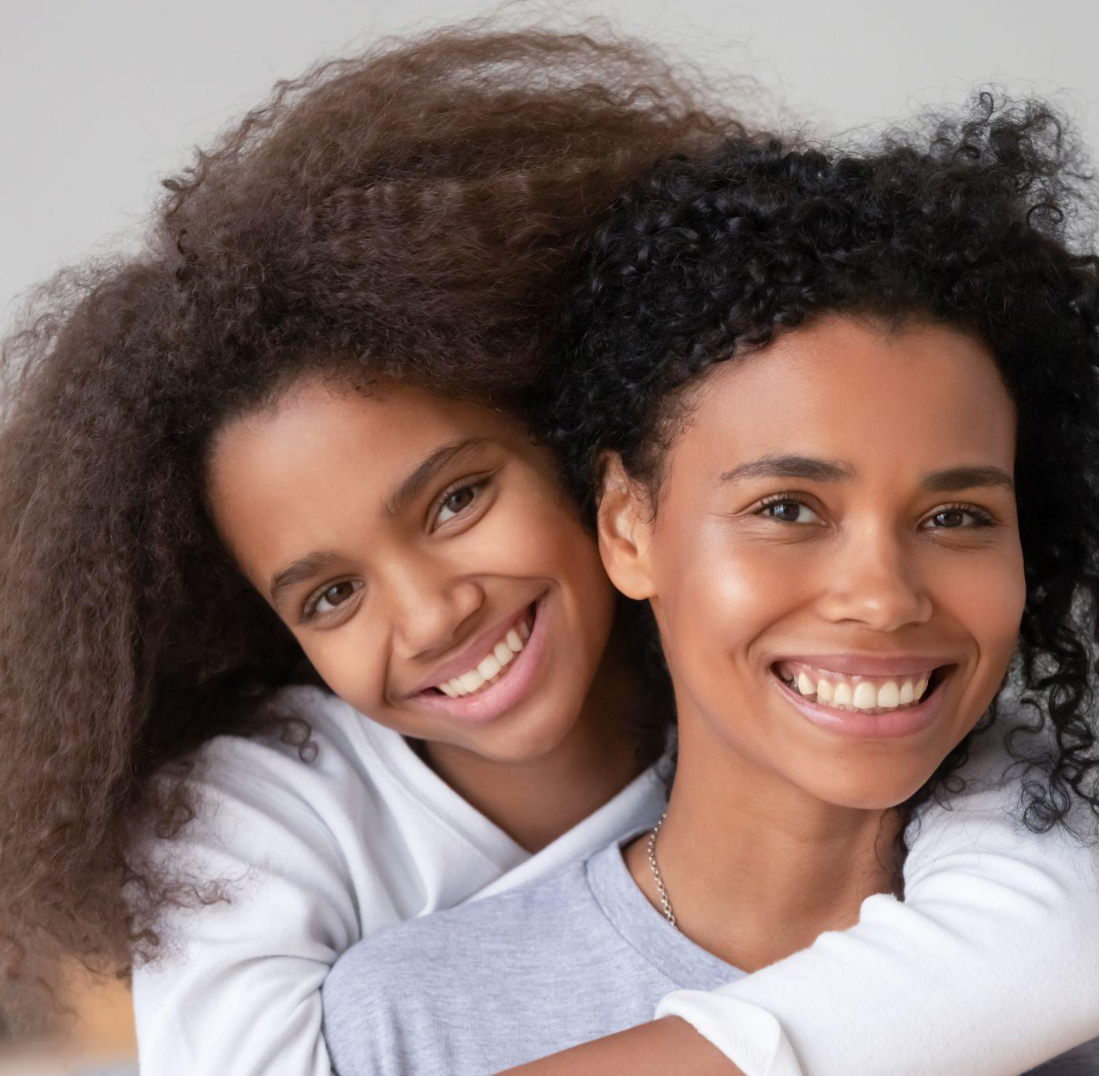
4. The language of the body
Be respectful, be responsible
What will you choose?
1. I can proactively choose to treat people with respect and to stand up for the dignity of others.
OR
2. I can be passive and go along with the objectification that I witness around me.

Slide 15
Year A. 4. The language of the body
Build resilience
Reflect on the small, largely unnoticed things your body allows you to do and which you take for granted. Make a list of five little things you are grateful for about your body – for example your sense of taste, your ability to walk/see/climb, your ability to play sport, to listen to music, to be physically close to those you love…

