Slide 1
Seachtain na Scoileanna Caitliceacha 2024
Scoileanna Caitliceacha:
Pobail na Seirbhíse
Notes:
Íomhánna ó Pexels.com
Sleamhnán 4 – Teaghlach ag guí https://www.pexels.com/photo/a-family-holding-hands-in-reciting-a-prayer-5813816/
Sleamhnán 5 – Altú Roimh Bhia - https://www.pexels.com/photo/top-view-of-a-family-praying-before-christmas-dinner-5779170/
Sleamhnán 6 – An Teaghlach lena Chéile https://www.pexels.com/photo/group-of-people-posing-at-a-wedding-reception-at-a-park-17841519/
Sleamhnán 7 – Dul sa Seans https://www.pexels.com/photo/flexible-man-practicing-climbing-on-wall-5383744/
Sleamhnán 8 – Teaghlach sa Sneachta https://www.pexels.com/photo/back-view-of-a-family-in-winter-clothes-walking-on-a-snow-covered-ground-6617800/
Sleamhnán 9 – Teaghlach ar na Céimeanna https://www.pexels.com/photo/a-family-with-twin-baby-boys-and-a-daughter-posing-outdoors-16949263/

Slide 2
Dé Céadaoin: Seirbhís i Measc Phobal an Teaghlaigh

Slide 3
An Teaghlach
agus
Freastal

Slide 4
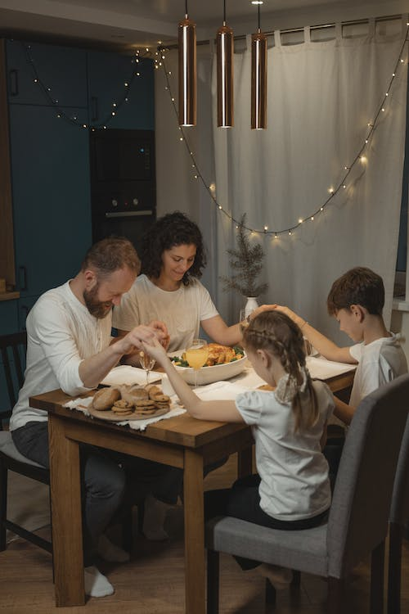
‘An teaghlach a ghuíonn lena chéile, fanann siad le chéile.’ – An tAthair Patrick Peyton

Slide 5
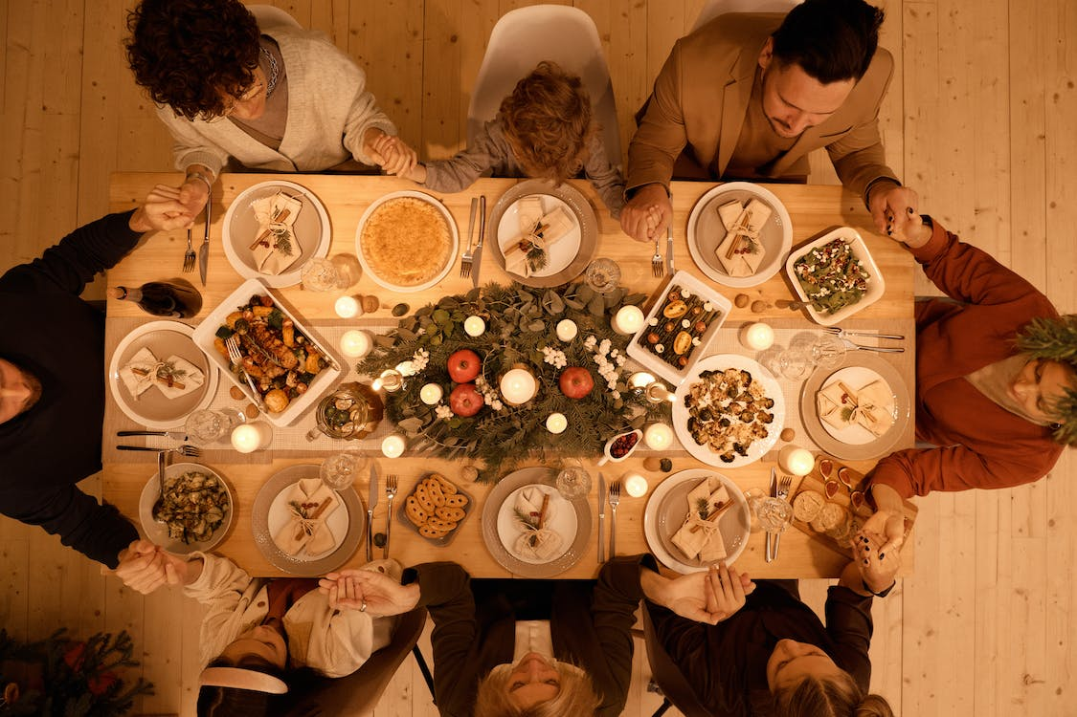
Beannacht ó Dhia orainne
atá ag suí chun boird le chéile……..

Slide 6
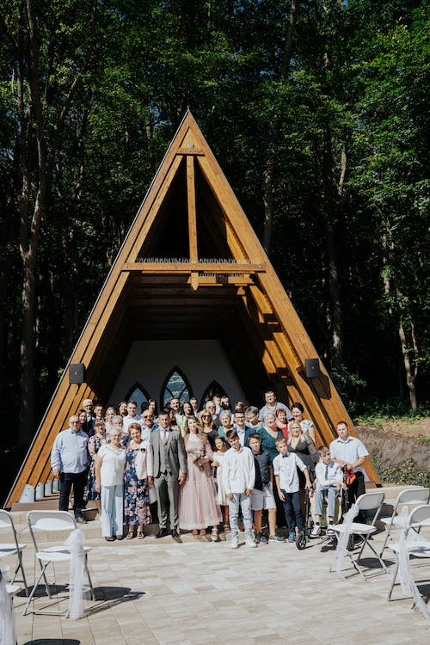
‘Is radharc roimh ré ar neamh é an teaghlach sona.’ - Sir John Bowring

Slide 7
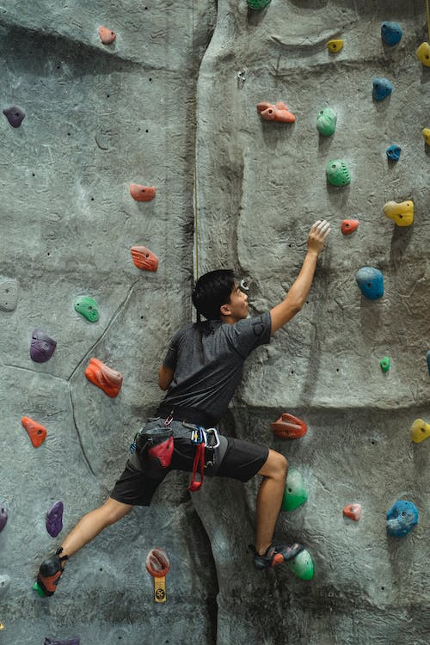
‘Bímid ag dul sa seans nuair a bhíonn baint againn le teaghlach. Dá mhéad é an grá, sea is mó an chailliúint ... Sin an trádmhalartú atá ann, ach glacaim go fonnmhar leis.’ - Brad Pitt

Slide 8
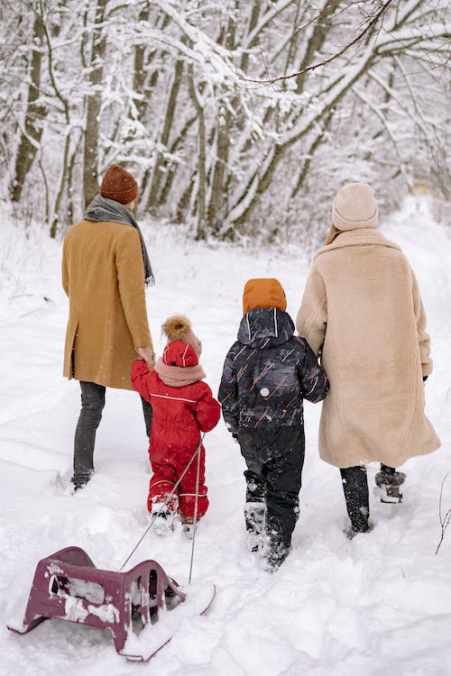
‘Tugtar uchtach iontach dúinn mar chomhluadar an teaghlaigh, agus ag an am céanna cuirtear éagsúlacht dhlisteanach an duine chun cinn.’ – An Pápa Proinsias

Slide 9
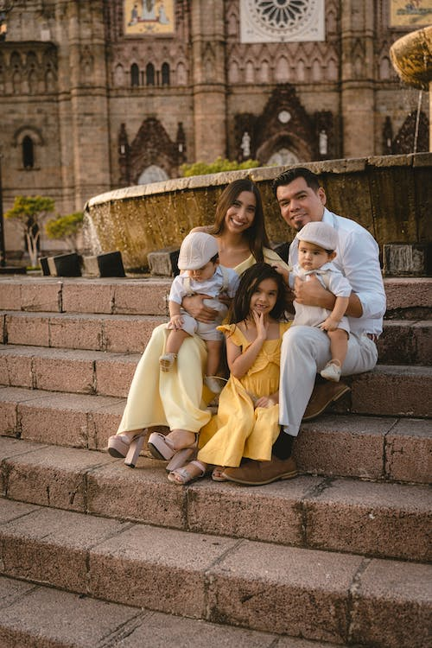
‘Cothaíonn grá an teaghlaigh mé.’ - Maya Angelou

