Slide 1
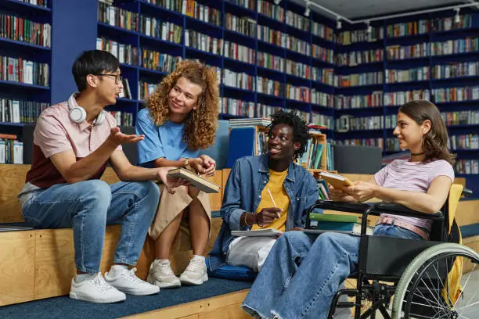
Catholic Schools Week 2024
Tuesday: Service in our School Community
Notes:
All images from Pixabay except image of Pope Francis from Reuters/L'Osservatore Romano.
Slide 1 – Young people https://www.istockphoto.com/photo/diverse-group-of-students-vibrant-gm1417921862-464824444
Slide 2 – Linked hands
https://pixabay.com/photos/hands-friendship-together-people-3331216/
Slide 3 – Care of the world https://pixabay.com/photos/earth-hour-clock-time-hands-hold-4300085/
Slide 4 – Hands
https://pixabay.com/photos/hands-world-map-global-earth-600497/
Slide 5 – Pope Francis with young people
Reuters/L'Osservatore Romano
Slide 6 – Children https://pixabay.com/photos/siblings-brother-sister-children-817369/
Slide 7 – Writing https://pixabay.com/photos/writing-writer-notes-pen-notebook-923882/
Slide 8 – Studying https://pixabay.com/photos/people-girls-women-students-2557396/
Slide 9 – Fireworks https://pixabay.com/photos/fireworks-new-years-eve-city-sky-1953253/
Slide 10 – Prayer
https://pixabay.com/photos/hands-open-candle-candlelight-1926414/

Slide 2
Global Compact on Education
In May 2020 Pope Francis held a meeting with many leaders of different religions all over the world on the Global Compact on Education. Compact means agreement. It was particularly aimed at those involved in education and young people.
Watch the short video of Pope Francis’ message for the Global Compact on Education at the link below:
https://www.youtube.com/watch?v=Tdau9DFtMn8
Notes:
YouTube link: https://www.youtube.com/watch?v=Tdau9DFtMn8

Slide 3
Pope Francis called on young people to participate in this meeting:
‘I also call upon you, dear young people, to take part in the meeting and to sense your real responsibility for the building of a better world.’

Slide 4
Pair and Share
Discuss with your partner three ways in which young people can uniquely contribute to the building of a better world.

Slide 5
‘Young friends, don’t wait until tomorrow to contribute your energy, your audacity and your creativity to changing our world. Your youth is not an “in-between time”.’ (Christus Vivit, 178) 1. What does Pope Francis mean when he says young people could view the teenage years as being an ‘in-between time’? 2. In what ways could these years be wasted? 3. Audacity means to take bold risks. How can young people take risks to make the world a better place? Reflection Time: In your school how can you contribute your energy, audacity and creativity to better serve your school community ?

Slide 6
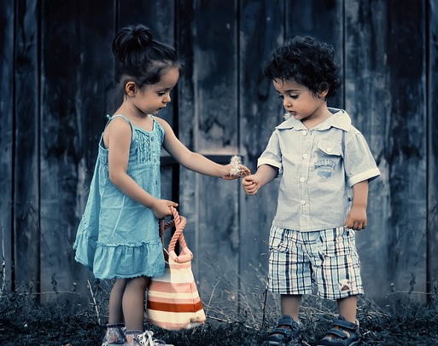
‘Christ Has No Body’ by St Teresa of Ávila (1515–1582) Christ has no body but yours, No hands, no feet on earth but yours, Yours are the eyes with which he looks Compassion on this world, Yours are the feet with which he walks to do good, Yours are the hands, with which he blesses all the world.
What do you think St Teresa means when she says Christ has no body but yours?
In what ways can you be compassionate in your school environment?
Can you think of one way in which you can be of service to somebody in school?
How can you be a blessing to your school?

Slide 7
Reflection Time
Complete Worksheet 1 that comes with this PowerPoint.

Slide 8
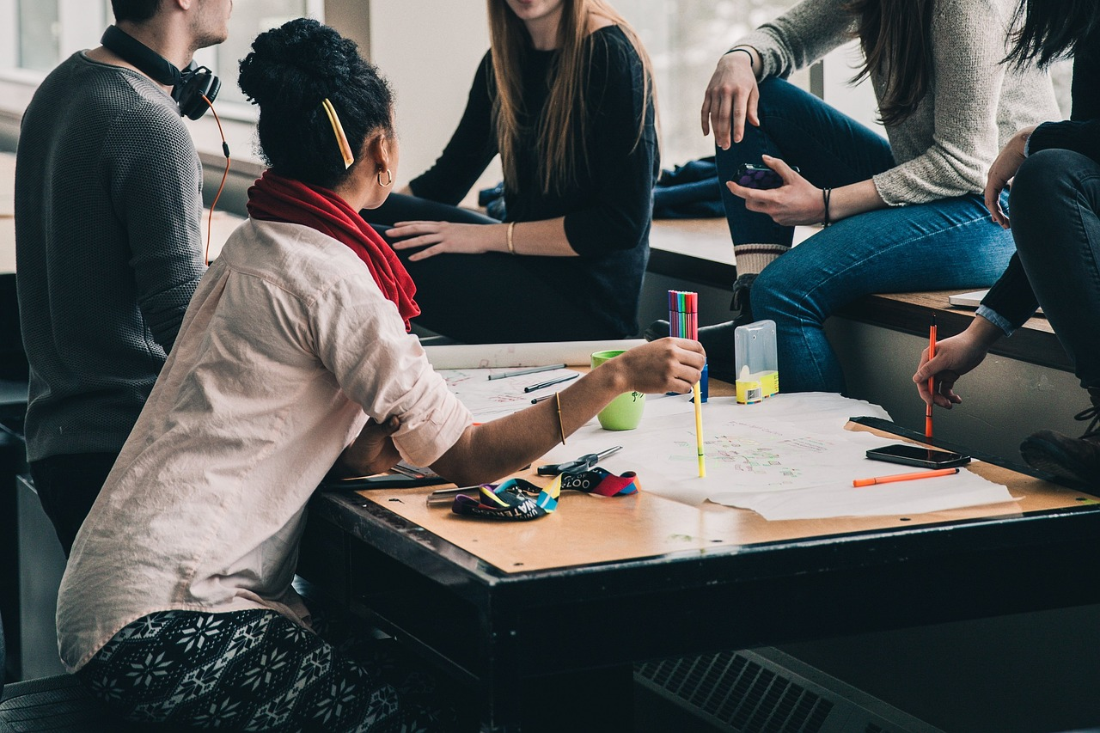
Group Work!
At the Global Compact on Education meeting, Pope Francis spoke about needing to listen to the opinions of young people. What suggestions would you give him about creating a school environment where all students are welcomed and valued?
When you have completed your Worksheet, bring your ideas from the final question (above) to your group and together choose the three best suggestions from the group to share with the class.

Slide 9
Firework – Katy Perry Listen to ‘Firework’ by Katy Perry via the link below and refer to Worksheet 2 for questions relating to the video.
https://www.youtube.com/watch?v=QGJuMBdaqIw

Slide 10
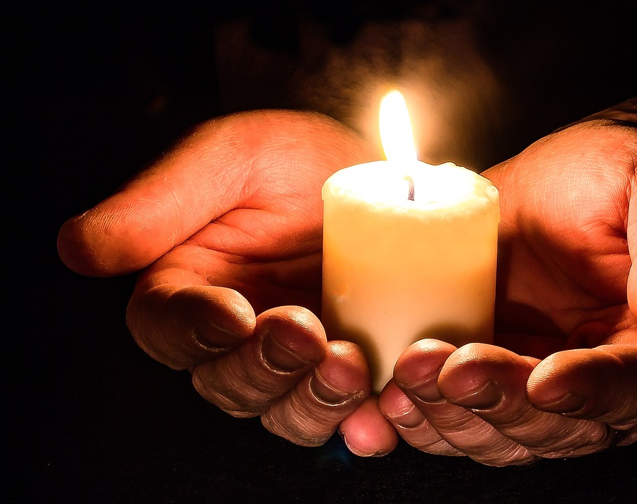
Prayer – Serving our School Community
Dear God,
As we celebrate Catholic Schools Week this week, help us to remember that we are called by faith to share the love of God in our school with all those we meet. Each person, at every age, is called to become Christ for one another by serving every person with a humble heart and with a generous spirit. Help us to be always aware of the blessing of our community and the chance for each of us to be members of it. Help us to live out your gospel in all the things we do and say and to be shaped as your disciples.
Amen.

