Slide 1
Living Love
Explaining the Christian foundation
Notes:
Note for Teachers - The Vision and Purpose of Living Love
The Catholic school has a fundamental mission to bear witness to the Gospel of Jesus Christ across the entire curriculum. How we do this is key.
As Pope St John Paul wrote: “the Church addresses people with full respect for their freedom. Her mission does not restrict freedom but rather promotes it. The Church proposes; she imposes nothing. She respects individuals and cultures, and she honors the sanctuary of conscience.” Encyclical letter Redemptoris Missio (Mission of the Redeemer), 39
This invitational dynamic must be the spirit with which every lesson in Living Love is delivered.
Your students are being invited to explore with you their teacher, critical and urgent issues relating to personal and moral development in an atmosphere of genuine dialogue and respectful debate.
In no way is some of the content in the lessons to be perceived as statements of judgement on individual persons or situations and all efforts must be made by the teacher to ensure that is understood.
You the teacher must have confidence in the message of “Living Love” sharing it with clarity but humility and patience, trusting that on some occasions it will be perfectly reasonable to allow the pace of the lesson to be student led.
“Finally, the prudence of a teacher who is most careful to make allowances for the psychological and moral circumstances of his hearer, particularly.. a child, unprepared, suspicious or hostile. The person who speaks is always at pains to learn the sensitivities of his audience, and if reason demands it, he adapts himself and the manner of his presentation to the susceptibilities and the degree of intelligence of his hearers. In a dialogue conducted with this kind of foresight, truth is wedded to charity and understanding to love”. Pope St Paul VI Ecclesiam Suam 81;82

Slide 2
Explaining the Christian foundation
Explaining the Christian foundation
Why do we need this resource specifically for schools with a Catholic ethos?
Because whether or not you have faith will impact on your understanding of the big questions in life – what is life about? What does it mean to be human? How do I find happiness?
In this short section we will clarify the foundational concepts at the heart of the Christian faith – we are each loved immeasurably by God, who wants us to live in love and find happiness with him in heaven forever. This introductory lesson will explore what love is from a Christian perspective and how morality helps love to grow. That may seem a little like an extract from RE class, but this will pave the way for more meaningful and fruitful dialogue and discussion in the main body of the resource, so don’t skip ahead.
Notes:
This is not a religious education resource, and it is designed to be accessible to people of all faiths and none.
It is written from a Christian point of view, with an openness to dialogue and encounter with those of other beliefs.
Christian perspectives are probably quite different from what you hear all around you in peer groups, social media and television, so we need to make sure you have a good idea of where we are coming from before we start talking about the concrete life issues and choices you are faced with as a teenager.

Slide 3
Explaining the Christian foundation
What is love?
When we look inside our hearts, we can all recognise the longing for love and belonging. That longing leads us out of ourselves and into relationship with God and with others. We all feel that call to love and be loved. The word ‘love’ in English can be used for the most trivial things, to the most sacred – you could say ‘I love my new shoes’ or ‘I love chocolate’, and it’s the same word we use to express our deepest loves – for the person we marry, or a parent speaking love to their child. So, what is love?
Notes:
Think, pair, share
With a partner, see can you come up with a definition of love.
Share your definitions with the class, and see what they have in common. Does everyone agree what love is?
Does your definition of love cover any situations where love is hard work, not just a feeling?
One way of defining love is wanting what’s good for the other person. How does that compare to the definitions you came up with?

Slide 4
Explaining the Christian foundation
What do we learn about love in the Bible?
Pope Benedict XVI describes the Bible as a ‘love-story’ where God ‘comes towards us, he seeks to win our hearts’ (Deus Caritas Est 17). We read in the Bible that ‘God is love, whoever abides in love, abides in God.’1 Jn 4:16.

Slide 5
Explaining the Christian foundation
Christians believe that God is not merely an abstract concept or an impersonal force, or even a machine that can be manipulated or controlled, but is personal. The common phrase is ‘a personal God’.
Notes:
God knows each of us by name, chose to call us into existence, and loves us with a love beyond anything we can imagine.
God, Christians believe, knows and understands us even better than we do ourselves – sometimes we act in ways that we don’t understand, but
God always understands what it is that drives us.
He calls each one of us into a loving relationship with him in this life and prepares eternal happiness for us with him in heaven, where every tear will be wiped away and all the longings of our hearts will be fulfilled.

Slide 6
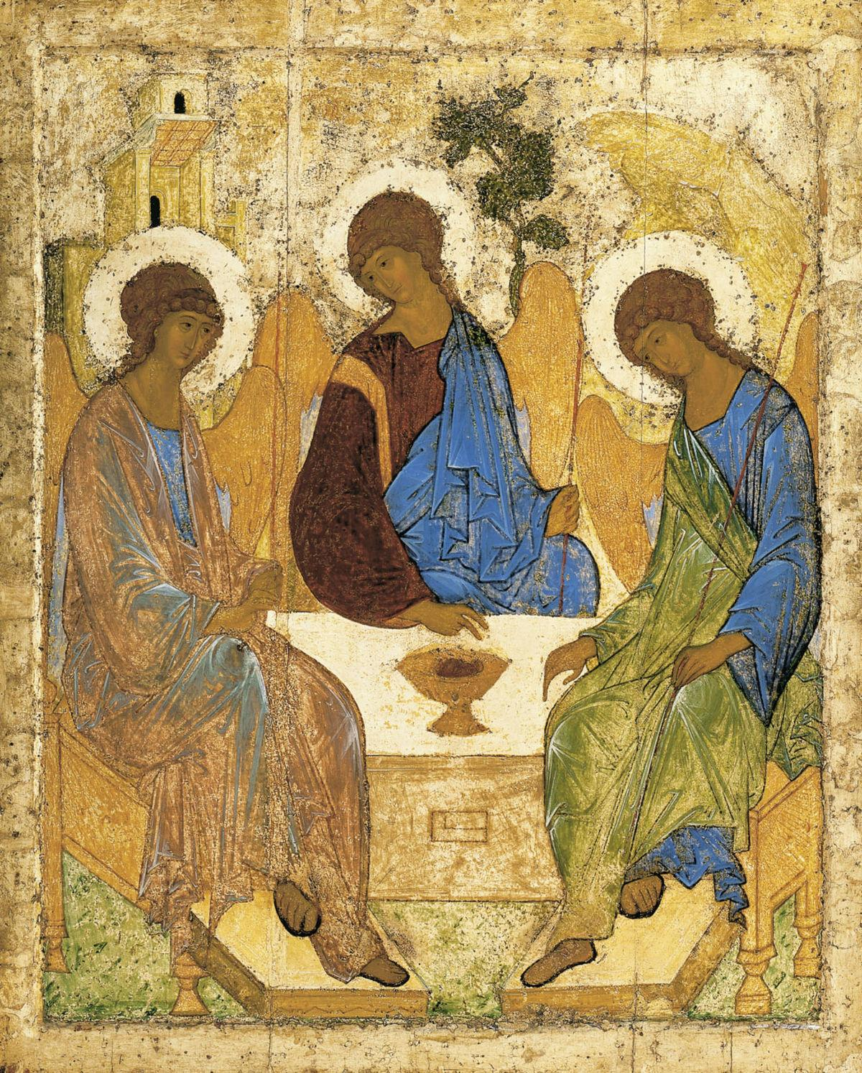
Explaining the Christian foundation
In this famous icon by the fifteenth-century Russian icon painter Andrei Rublev, the three angels who visit Abraham and Sarah (Genesis 18) are used to represent the Trinity of Father, Son and Holy Spirit, with the three figures forming a united circle and the image centred on the cup as an image of sacrifice. The icon helps us see that God himself exists in relationship, and that there is a space left at the table – you are invited to come and sit down with the Trinity, invited into the love of God.

Slide 7
Explaining the Christian foundation
Jesus is the sign of that love – Jesus came to show us the love of the Father and to invite each of us into the loving communion of the Trinity. As we receive the love of God, we in turn are called to pass it on to others, to love like Jesus – ‘love one another as I have loved you’ (John 13:34).
Time and again Jesus stressed that Christians are called to love, saying that the most important commandments are to love God with all our heart, our understanding and our strength, and to love our neighbours as ourselves (Mark 12:29-31). He said that we are called to love everyone, recognising them as our neighbours (Luke 10:25-37), and that in showing love to all those who need it we show love to Christ himself (Matthew 25: 31-46).

Slide 8
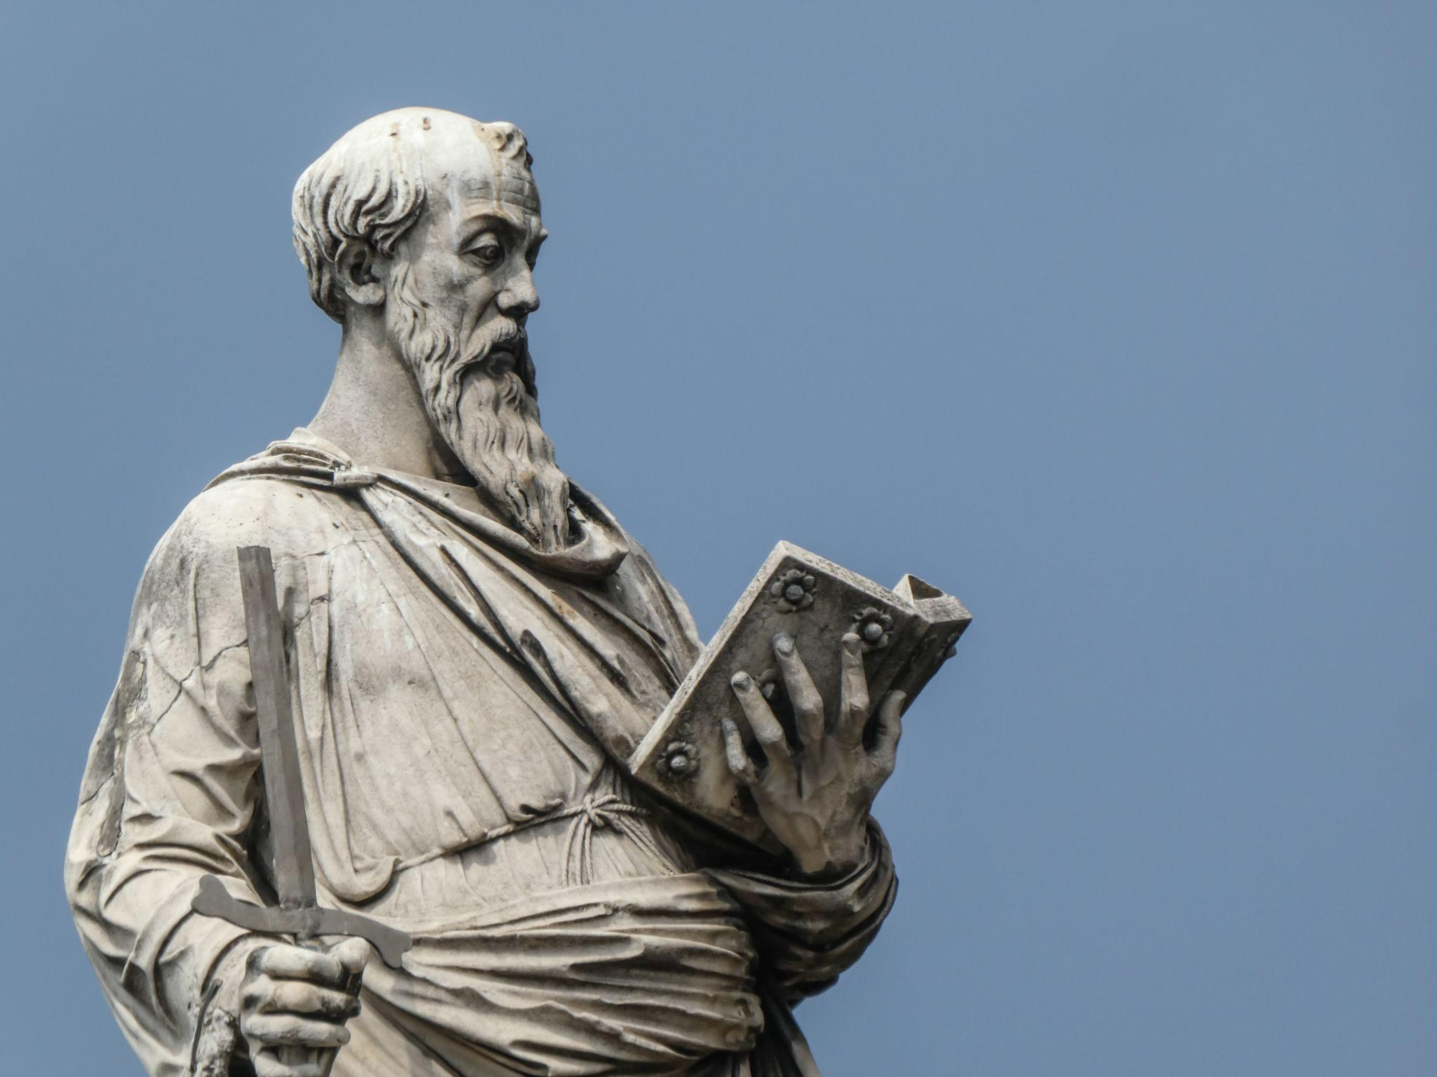
Explaining the Christian foundation
St Paul describes how we are called to love each other. This description of love is often read at weddings:
‘Love is patient; love is kind; love is not envious or boastful or arrogant or rude. It does not insist on its own way; it is not irritable or resentful; it does not rejoice in wrongdoing, but rejoices in the truth. It bears all things, believes all things, hopes all things, endures all things. Love never ends.’ (1 Corinthians 13:4-8)
Notice that this is a description that tells us what love is like, and that it describes ways of behaving. It is not always easy to behave in a loving way, but it is important to remember that love isn’t just a matter of how we feel, but what we do.

Slide 9
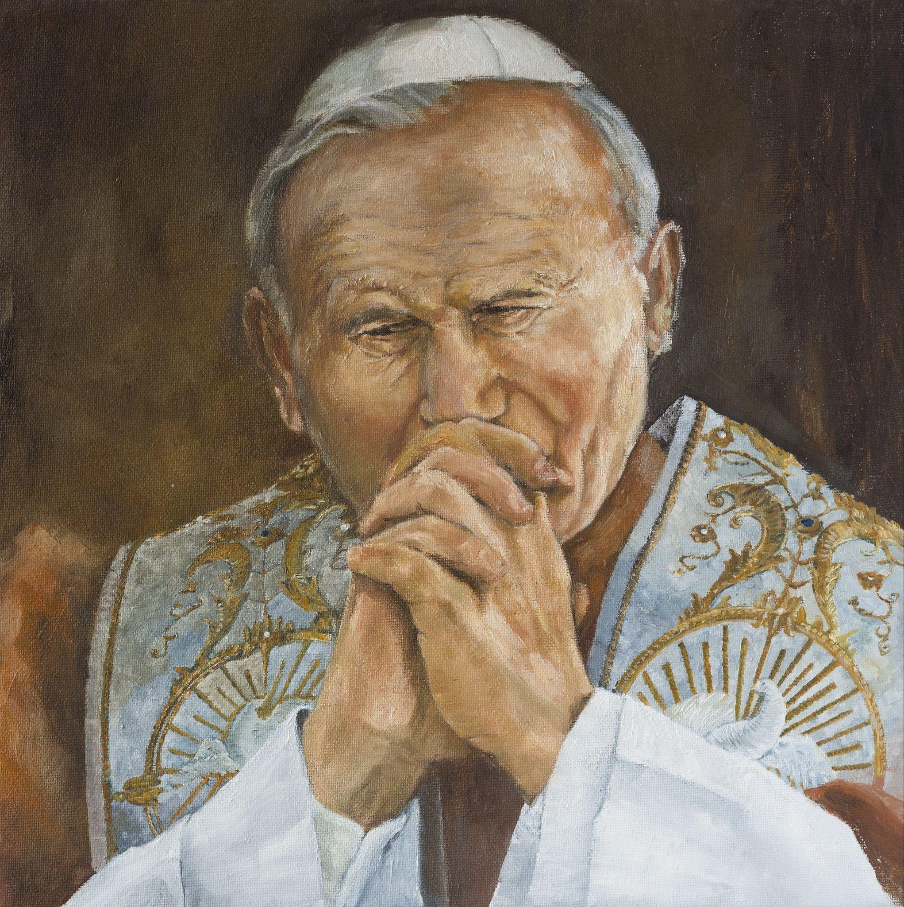
Explaining the Christian foundation
Reflect
Pope John Paul II described this kind of love as the ‘fairest love’, meaning the most beautiful love.
Is this the kind of love that you would like to experience in your life?
Do you think it is possible for you to love like this?
What makes it hard to love?
Notes:
If you have time show this video of John Paul II speaking to young people in Galway in 1979
https://www.youtube.com/watch?v=NRlObLZZ4OE

Slide 10
Explaining the Christian foundation
What about sex?
The call to love is written on and in the human body. There’s an important sense in which when we look at the male and female body in isolation they are incomplete: as a species, it takes male and female working together to bring new life into the world. This is a sign of the love that God has for humanity, a love of joy and self-giving.
Notes:
Christians understand marriage as being a ‘conjugal’ institution – that is, as a social and institutional expression of the biological reality that as a species it takes a man and a woman together to bring new human life into the world.
That it takes years of time and effort to raise and support human children until they are independent adults.
Throughout human history marriage has been recognised as a uniquely important institution which supports family life and society more generally, and Christians have recognised marriages between Christians as an indissoluble sacramental commitment.

Slide 11
Explaining the Christian foundation
Pope Francis describes marriage and how it expresses human realities as follows:
‘After the love that unites us to God, conjugal love is the “greatest form of friendship”. It is a union possessing all the traits of a good friendship: concern for the good of the other, reciprocity, intimacy, warmth, stability and the resemblance born of a shared life. Marriage joins to all this an indissoluble exclusivity expressed in the stable commitment to share and shape together the whole of life. Let us be honest and acknowledge the signs that this is the case. Lovers do not see their relationship as merely temporary. Those who marry do not expect their excitement to fade. Those who witness the celebration of a loving union, however fragile, trust that it will pass the test of time. Children not only want their parents to love one another, but also to be faithful and remain together. These and similar signs show that it is in the very nature of conjugal love to be definitive. The lasting union expressed by the marriage vows is more than a formality or a traditional formula; it is rooted in the natural inclinations of the human person.’ (Amoris Laetitia 123)

Slide 12
Explaining the Christian foundation
Sex can’t be separated from the meaning it has, written into the human body, male and female. Although every human being is called to live in love, not everyone is called to an active sexual life as an expression of love. In our culture today, sex is often seen as a right that people have, but the Christian perspective is different – sex is a gift to be enjoyed within marriage for those who are called to marriage, helping to bring new life into the world and to bind couples together in faithful love as they raise their children and eventually even grandchildren, nurturing their relationship and serving their community.
Notes:
Every single human person is loved by God and is called to the ‘fairest love’ that Pope John Paul II talks about.
Some people are called to this love in marriage, and some are not. In our culture today, sex is often seen as a right that people have, but the Christian perspective is different – sex is a gift for those who are called to marriage.
While every human being is called to live in love, not everyone is called to sex as an expression of love. Sex can’t be separated from the meaning it has, written into the human body, male and female.

Slide 13
Explaining the Christian foundation
The love described by St Paul is not based on emotions or excitement, but it is a love that every human heart longs for.
To love in that way involves co-operating with the grace of God, growing in maturity, working on oneself to choose love over selfishness.
It’s like the training and dedication needed for any sport or hobby, but the goal and the rewards are much greater.
This path leads to a lasting happiness and peace that can’t be found in the easy paths.
Yes, it is demanding, but it is worth it, and our ultimate destination is Love itself – entering into the fullness of love and happiness with God in heaven.

Slide 14
Explaining the Christian foundation
Thought exercise
Imagine you are at the All Ireland hurling final. It’s a few minutes before the whistle blows, and there’s an announcement. The referee has just tested positive for a serious infectious disease, and all the other officials are close contacts. There is no one to referee the match.
Should the game go ahead or be postponed until they can find new match officials? Why?
If the match went ahead, do you think all the players would play by the rules, or try to win at all costs?
Perhaps some players would continue to play hurling by the rules. Others would forget about the rules, knowing they could ‘get away with it’ without a referee to intervene.
What do you think is the better choice? Why?
Do you think the game of hurling is better with or without rules?
What benefits do rules provide?
What would you do?

