Slide 1
Catholic Schools: Living Life to the Full
Friday – Living Life and Facing the Future

Slide 2
The present can confront us with many choices for the future – we reflect, we pray, we choose and go forward in hope.
Notes:
Image by Arek Socha: https://pixabay.com/photos/doors-choices-choose-decision-1767562/

Slide 3
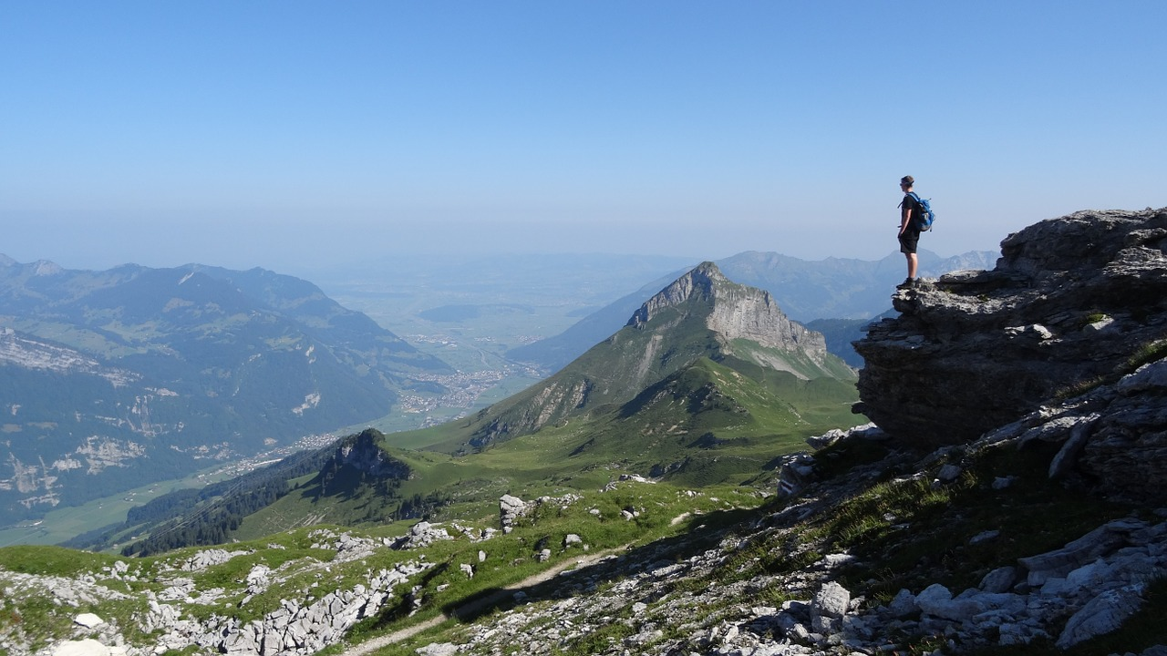
The future is like a rolling vista, a panorama, full of possibilities. We need to discern the best path, but there may be several paths that are appropriate for us on this great adventure into the future.
Notes:
Image by Free-Photos: https://pixabay.com/photos/person-cliff-mountain-top-peak-983960/

Slide 4
Our dreams in the present carry us on into the future. We may need courage to follow what inspires us. We seek harmony between the many aspects of our lives.
Notes:
Image by Deirdre Weedon: https://pixabay.com/photos/stones-dream-inspire-courage-451329/

Slide 5
Our dreams for the future help us to soar, to be gentle with ourselves while rising to the challenge to become our best selves.
Notes:
Image by Adina Voicu: https://pixabay.com/photos/butterfly-blue-wings-flight-insect-2837589/

Slide 6
We try to build our future on the foundation and framework we create in the present. We try to be genuine in building our character and in developing our relationships with others and with God.
Notes:
Image by Free-Photos: https://pixabay.com/photos/building-construction-site-cranes-768815/

Slide 7
‘I have come so that they may have life and have it to the full.’ (John 10:10)

