Slide 1
Catholic Schools Week 2023
Walking Together in Love

Slide 2
We journey with friends
and fellow students …

Slide 3
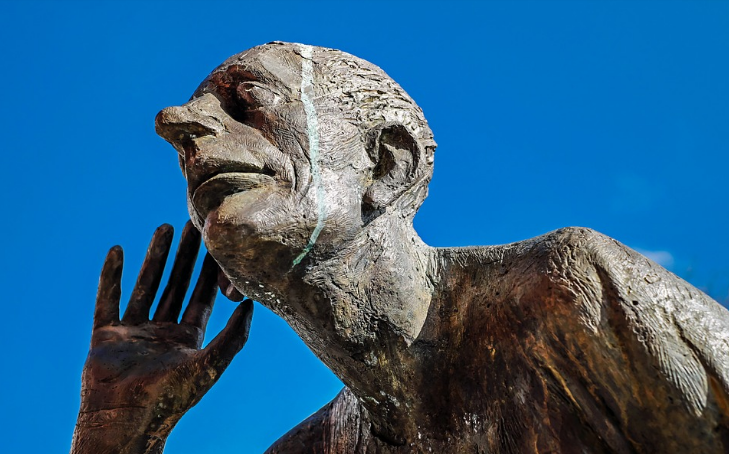
We listen to other people
in school …

Slide 4
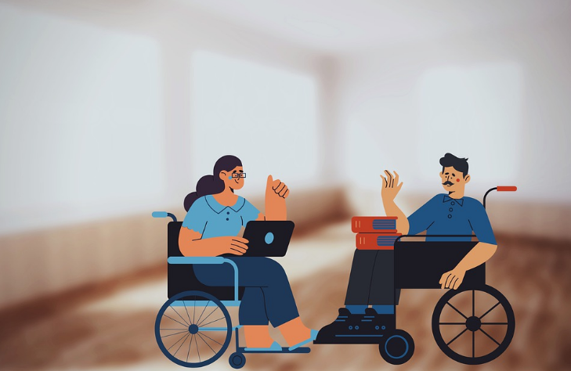
We dialogue with teachers, friends and fellow students …

Slide 5
We include and welcome …

Slide 6
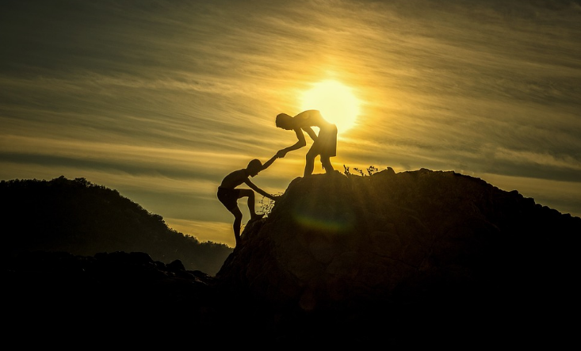
We support each other ….

Slide 7
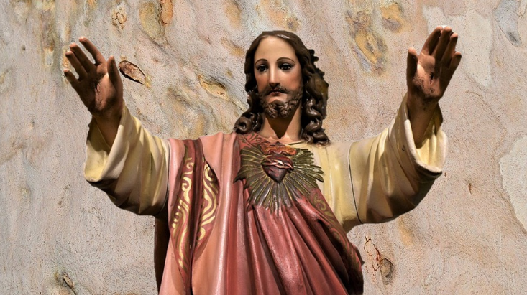
Inspired by the love of God …

