Slide 1
Catholic Schools Week
2023
Walking Together in Faith

Slide 2
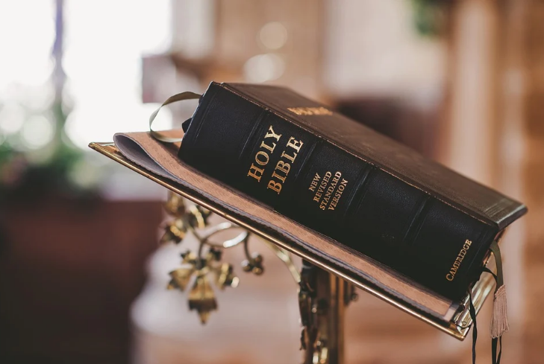
Faith – a response to the Word of God
How do we respond to the Word of God?

Slide 3
Faith is both expressed in and nourished by prayer and worship.
How well do we pray?

Slide 4
Faith brings knowledge. The one who believes is able to recognise the truth of God.
Have we enough knowledge of our faith? How could we increase our knowledge of the faith?

Slide 5
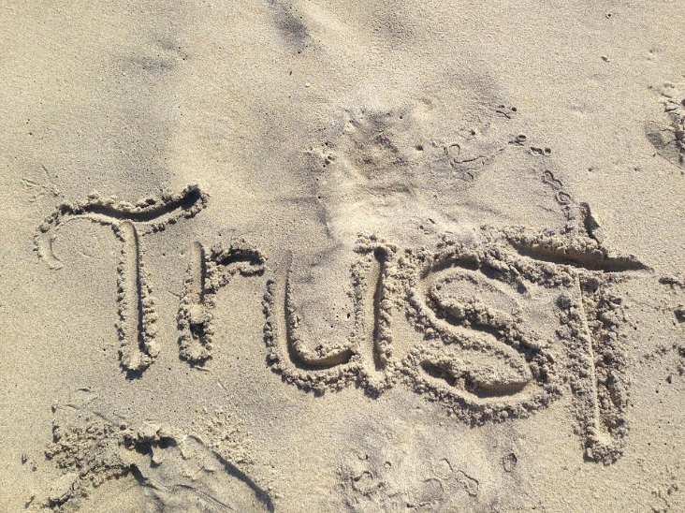
Faith involves confidence. To trust in God means to base one’s whole life on the promise of God.
How do we show our trust in God?

Slide 6
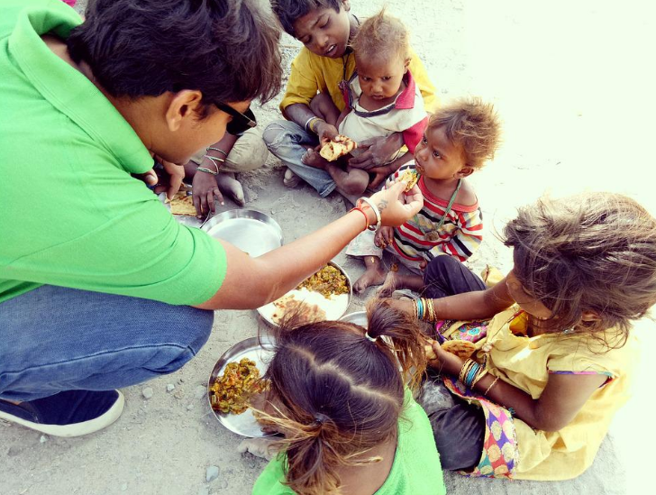
Faith entails responsibility, and especially charity and service.
How well do we show responsibility and do acts of service for others?

Slide 7
Faith requires repentance.
What aspects of our behaviour do we need to improve on?

Slide 8
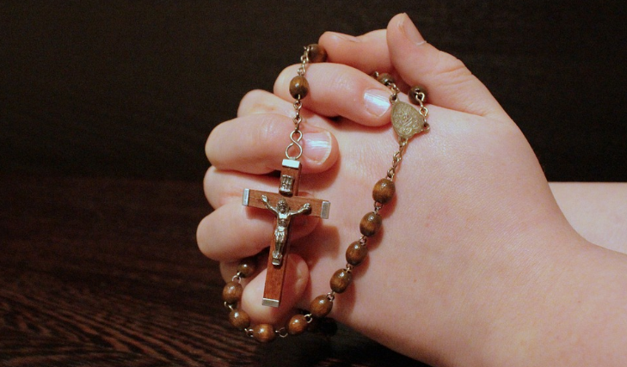
Believers are able to give an account of the hope that is in them. They do that in their own name; but they do it from within the communion of believers.
How well do I relate to my community of believers?

Slide 9
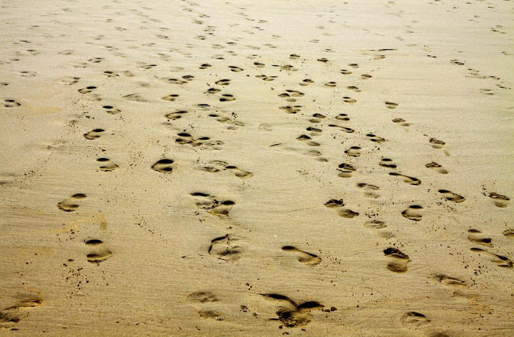
‘We walk by faith, not by sight.’
(2 Corinthians 5:7)

